Slide 1
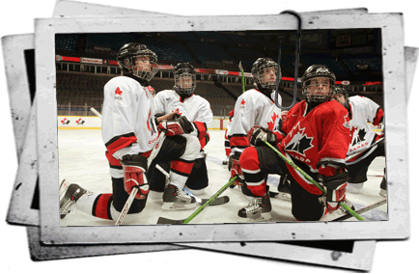
Hockey Canada
Development Programs
Long Term Player Development Programming Framework

Slide 2
Hockey Canada’s Mission Statement
“To Lead, Develop, and Promote positive hockey experiences.”
Challenge • Learn • Improve

Slide 3
Programming Goals – Participant Centered
Establish the “Gold Standard” for all hockey programming
Provide all participants with a positive experience focusing on building a strong skill base
Adhere to the principles of Long Term Participant Development (LTPD) in the design and application of age-specific programs

Slide 4
Long Term Player Development
Simply put, a Long Term Player Development model (LTPDM) is a framework to maximize a player’s potential and long term involvement in sport over the course of their life.
This philosophy sets out a vision for hockey in Canada that takes advantage of the history and culture of the game to increase participation and to lay the foundations of international success long into the future.

Slide 5
Long Term Player Development
Mission 10/10,000
Research has concluded that it takes a minimum of 10 years and 10,000 hours of deliberate training for a talented player to reach elite levels (Starkes and Ericsson, 2003).
This means before the 10 year or 10,000 hour rule comes into play:
1) A player must have developed the fundamental skills
2) Be physically literate
For a player and coach this translates into slightly more than
3 hours of training or competition daily for
10 years.

Slide 6
Long Term Player Development
Is based on the physical, mental, emotional, and cognitive development of children and adolescents. Each stage reflects a different point in athlete development.
Ensures physical literacy - upon which excellence can be built
Ensures that optimal training, competition, and recovery programs are provided throughout an athlete’s career.
Provides an optimal competition structure for the various
stages of an athlete’s development.

Slide 7
Long Term Player Development
Has an impact on the entire sport continuum, including participants, parents, coaches
Integrates elite sport, community sport and recreation, scholastic sport, and physical education in schools.
Supports the four goals of the Canadian Sport Policy — Enhanced Participation, Enhanced Excellence, Enhanced Capacity, and Enhanced Interaction — and reflects a commitment to contribute to the achievement of these goals.
Promotes a healthy, physically literate nation whose citizens participate
in lifelong physical activity

Slide 8
Long Term Player Development
This model for hockey has been developed based on the following principles:
Doing the right thing for the player at the right stage in their development
Adopting a player-centered approach and not treating the development of all players the same way.
The broader the foundation of players the more successful the game of hockey will be in Canada
Viewing player development as a long term process

Slide 9
Long Term Player Development
Aligning player development resources with the right age and ability
Coach development and education resources so that coaches are doing the right things at the right time. (skills manuals, DVD’s)
A need to better educate parents on the hockey development of their child. It is okay for parents to want their kids to get to the highest levels but they need to know the best way to go about it.

Slide 10
Long Term Player Development
Drawbacks in our development system
Over-competing & under training
Adult programs imposed on children
Male training programs imposed on females
Chronological rather than developmental age is used in training and competition planning.
Coaches largely neglect the critical periods of accelerated adaptation to training ( ages 9 – 12 )

Slide 11
Long Term Player Development
Drawbacks in our development system
Fundamental movement skills and sport skills are not taught properly.
Preparation geared to short-term outcomes
Knowledgeable coaches at the elite levels
Competition system interferes with athlete development
Early specialization is demanded
Parents are not educated about LTAD.

Slide 12
Long Term Player Development
Consequences - What are the results of these shortcomings?
Poor movement abilities.
Lack of proper fitness.
Poor skill development.
Bad habits developed from over-competition focused on winning.
Undeveloped and unrefined skills due to under-training.
Female athlete potential not reached due to inappropriate programs.
Children not having fun as they play adult-based programs.
No systematic development of the next generation of
successful International athletes.
Failure to reach optimal performance levels in
international competitions.

Slide 13
Long Term Player Development
Consequences - What are the results of these shortcomings?
Athletes pulled in different directions by school, club, and provincial teams because of the structure of competition programs.
Remedial programs, implemented by provincial and national team coaches, to counteract the shortcomings of athlete preparation.
Fluctuating national performance due to lack of a developmental pathway.
Athletes failing to reach their genetic potential and optimal
performance level.

Slide 14
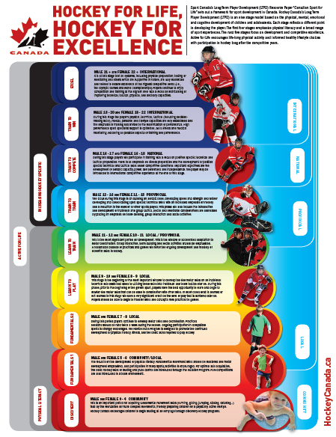
Long Term Player Development

Slide 15
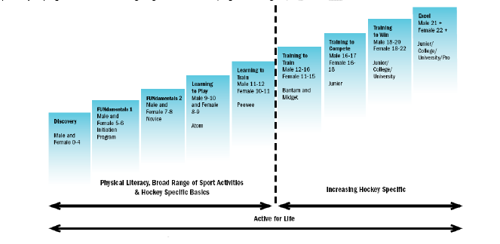
Long Term Player Development
The minor hockey player in Canada needs to experience a wide variety of learning activities that correspond to his or her level of abilities and capacities. Hockey Canada’s Long Term Player Development model has 8 stages. This could also be referred to as the Hockey Player pathway or progression. The following diagram outlines this progression in generic terms.
The minor hockey player in Canada needs to experience a wide variety of learning activities that correspond to his or her level of abilities and capacities. Hockey Canada’s Long Term Player Development model has 9 stages. This could also be referred to as the Hockey Player pathway or progression. The following diagram outlines this progression in generic terms.

Slide 16
Long Term Player Development
The following age specific charts are guidelines for developing a seasonal structure that is more conducive to player development

Slide 17
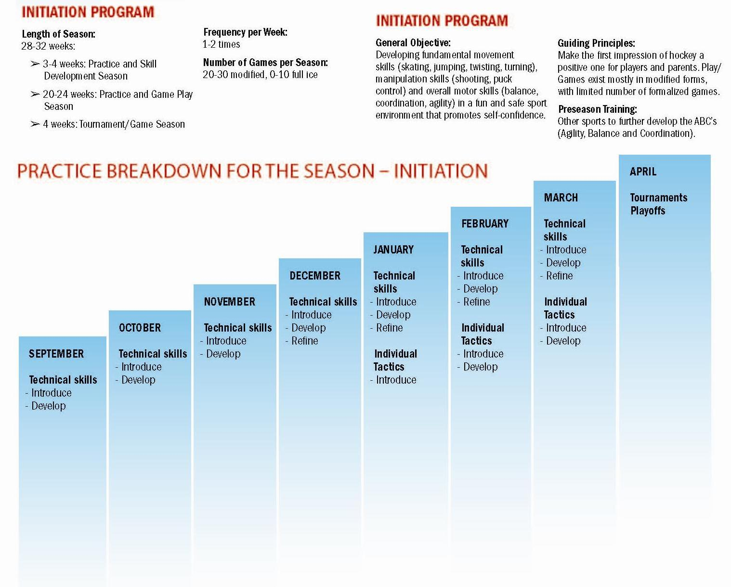
LTPD – Initiation
Age Group | Number of Practices | Start date for Practices | Development Season | Start date for Games | Development & regular Season | Playoff Season | Tournaments | Number of Games total
Initiation Ideal | 35 - 40 | Sept 15 | 10 weeks 20 practices 0 games | Dec 15 | 10 weeks 20 practices 10 games | N / A | 2 tournaments 8 games | 15 - 20

Slide 18
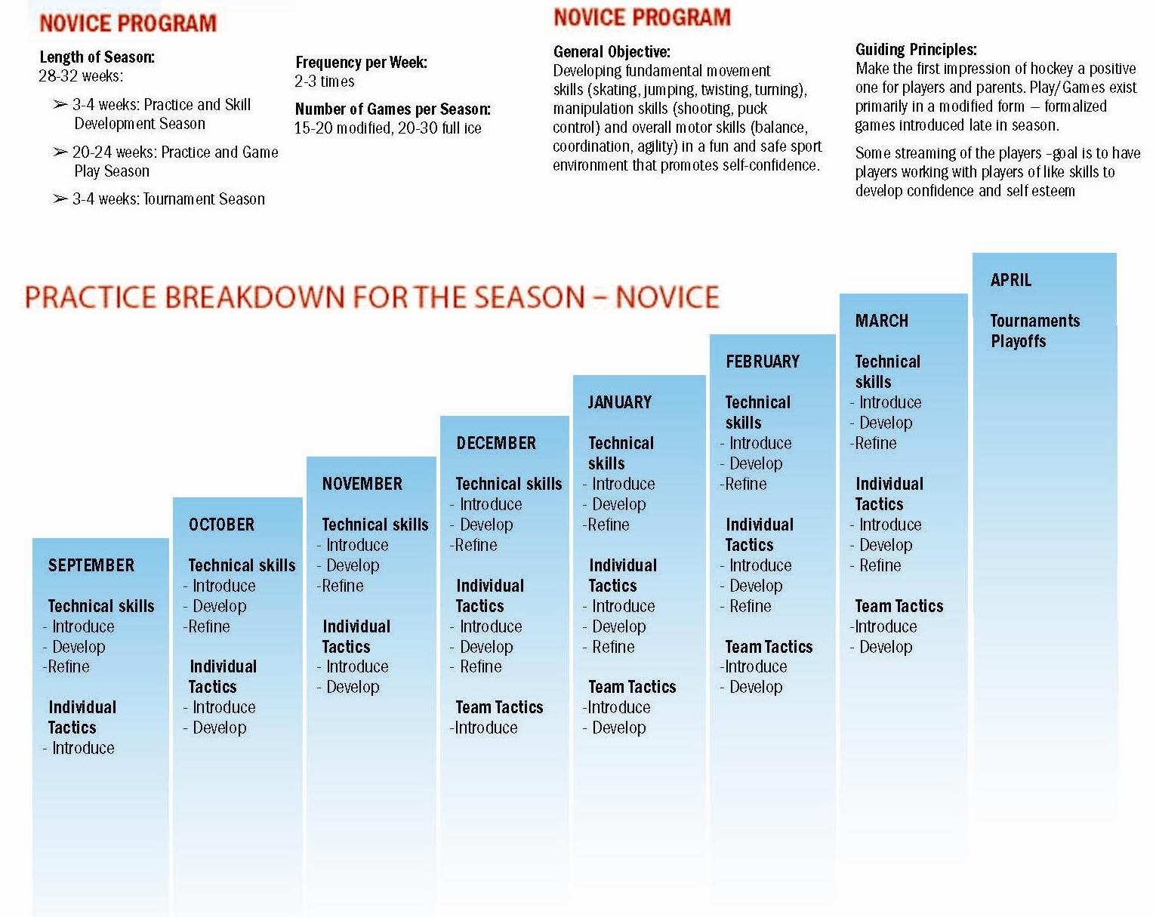
LTPD – Novice
Age Group | Number of Practices | Start date for Practices | Development Season | Start date for Games | Development & regular Season | Playoff Season | Tournaments | Number of Games total
Novice Ideal | 40 - 45 | Sept 15 | 10 weeks 20 practices 2 ex games | Dec 1 | 14 weeks 28 practices 16 games | N / A | 3 tournaments 12 games | 30 - 35

Slide 19
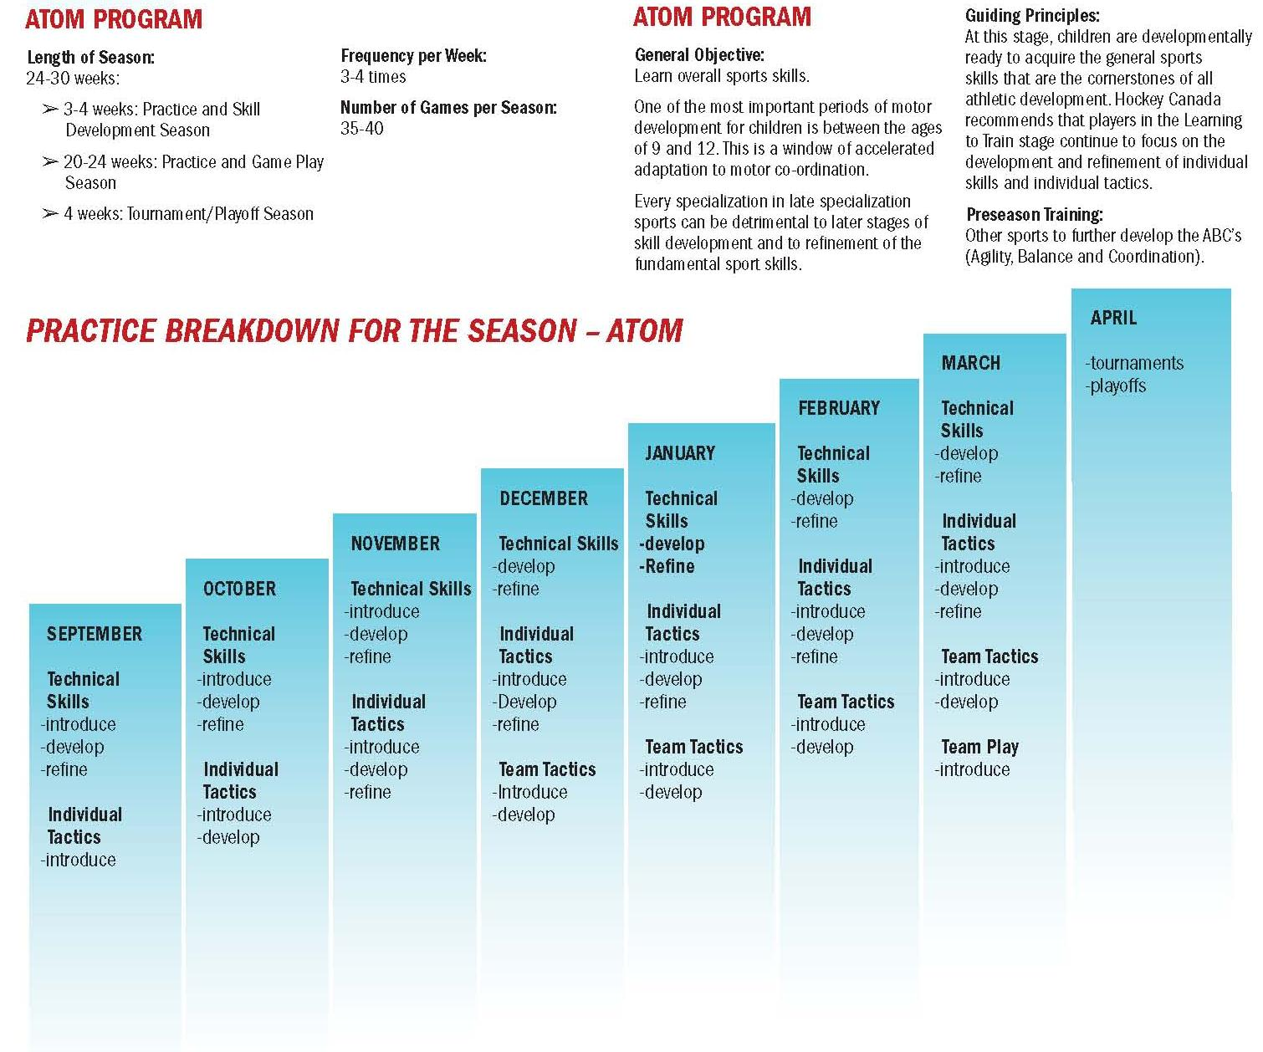
LTPD – Atom
Age Group | Number of Practices | Start date for Practices | Development Season | Start date for Games | Development & regular Season | Playoff Season | Tournaments | Number of Games total
Atom Ideal | 45 - 50 | Sept 15 | 6 weeks 12 practices 2 ex games | Nov 1 | 16 wks 32 practices 20 games | March 15 | 4 tournaments 16 games | 40 - 45

Slide 20
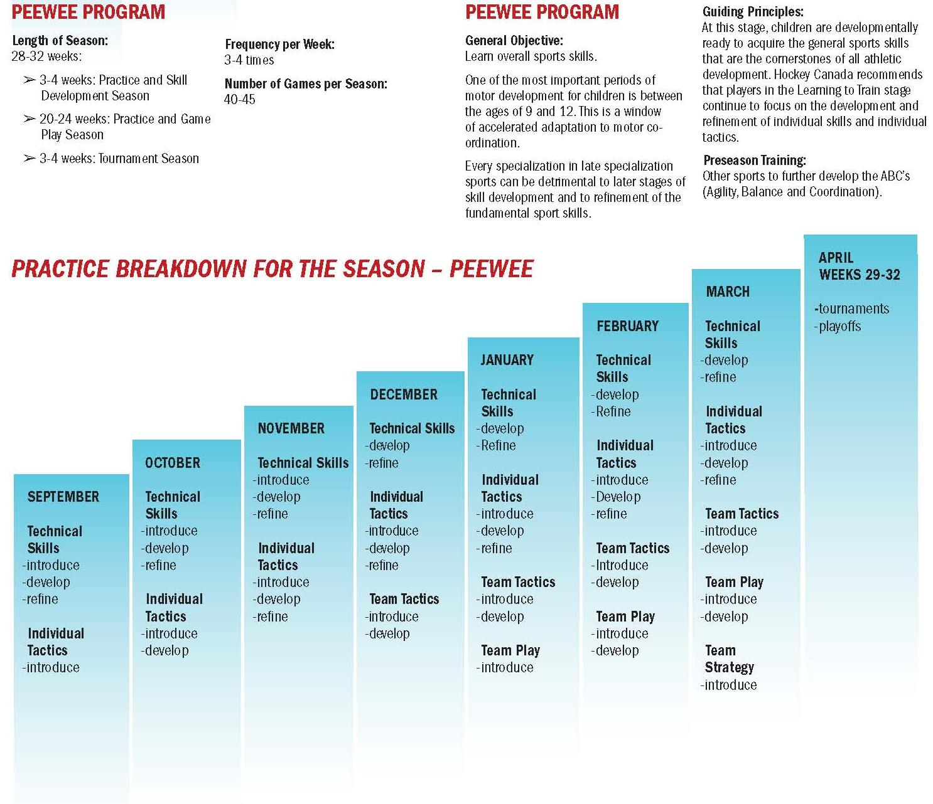
LTPD – Peewee
Age Group | Number of Practices | Start date for Practices | Development Season | Start date for Games | Development & regular Season | Playoff Season | Tournaments | Number of Games total
Peewee Ideal | 50 - 55 | Sept 15 | 4 weeks 12 practices 4 ex games | Oct 15 | 18 wks 36 practices 24 games | March 15 | 4 tournaments 16 games | 45 - 50

Slide 21
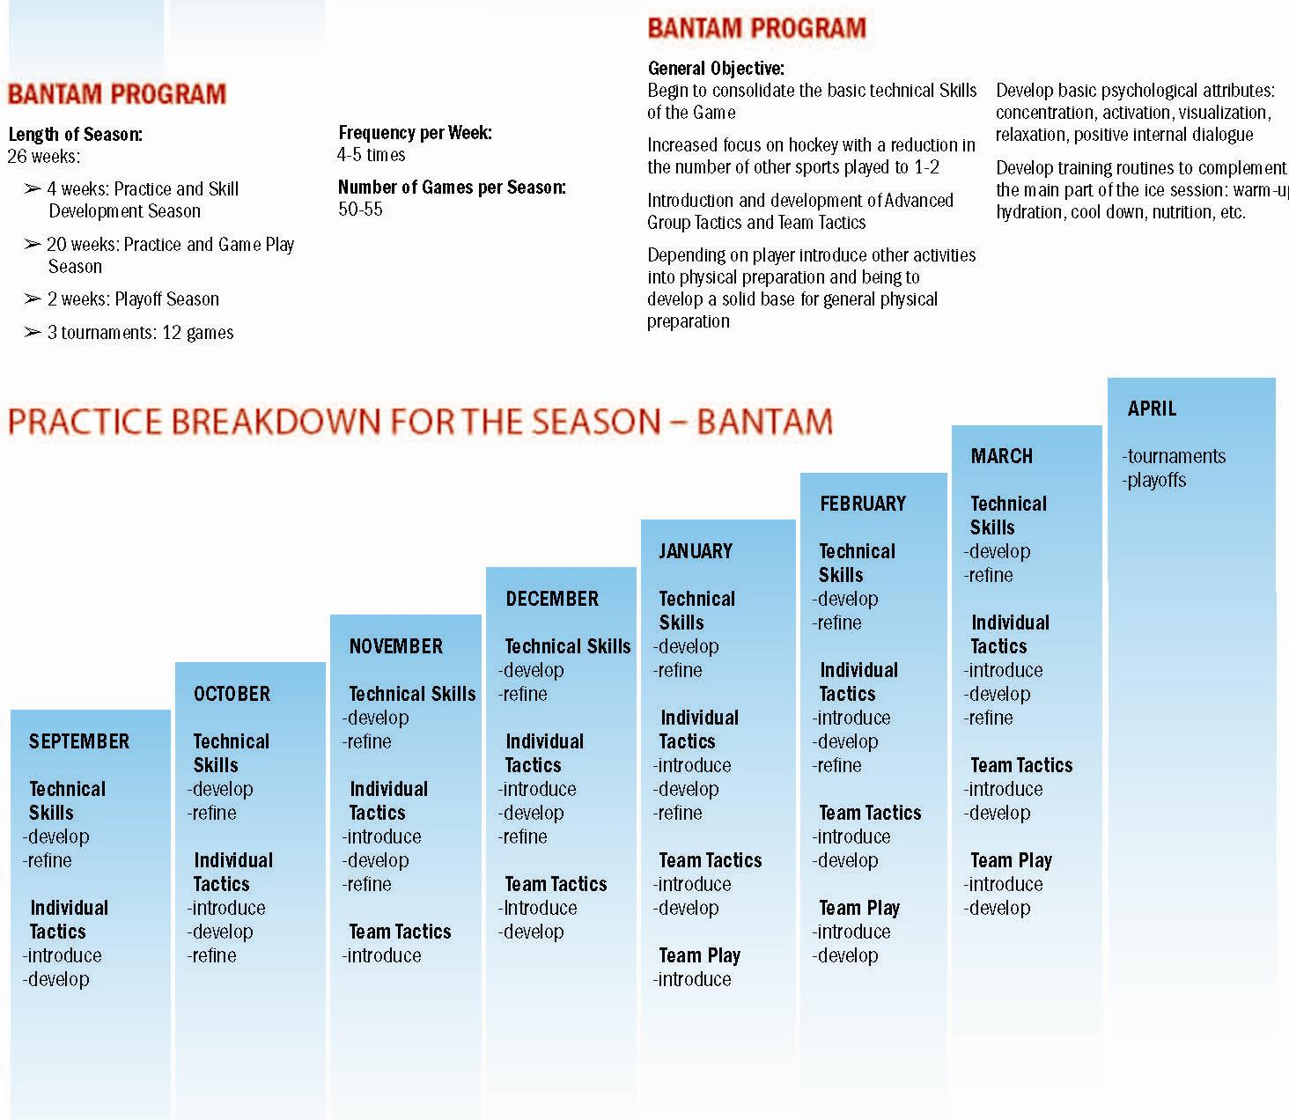
LTPD – Bantam
Age Group | Number of Practices | Start date for Practices | Development Season | Start date for Games | Development & regular Season | Playoff Season | Tournaments | Number of Games total
Bantam Ideal | 55 - 60 | Sept 15 | 4 weeks 12 practices 4 ex games | Oct 15 | 20 wks 40 practices 28 games | March 15 2 weeks 6 practices 8 games | 3 tournaments 12 games | 50 - 55

Slide 22
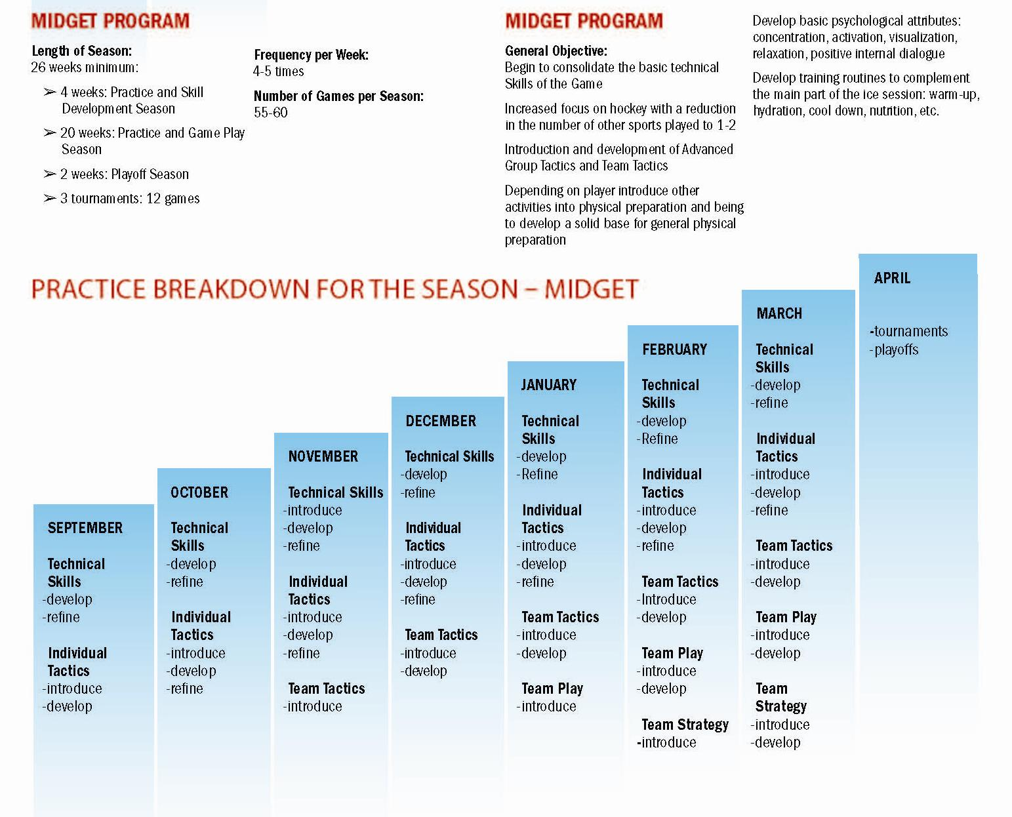
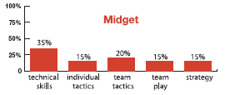
LTPD – Midget
Age Group | Number of Practices | Start date for Practices | Development Season | Start date for Games | Development & regular Season | Playoff Season | Tournaments | Number of Games total
Midget Ideal | 55 - 60 | Sept 15 | 4 weeks 12 practices 4 ex games | Oct 15 | 20 weeks 40 practices 32 games | March 15 2 weeks 6 practices 8 games | 3 tournaments 12 games | 55 - 60

Slide 23
Programming Goals – MHA Centered
What an MHA needs to do to improve:
-Focus on supporting the complete athlete not just the athlete training and competition.
-Introduce athletic skills in a systematic and timely way
-Recommend other sports, cross training methods to get away from hockey and avoid burn out
-Remove the focus of winning at all levels and age

Slide 24
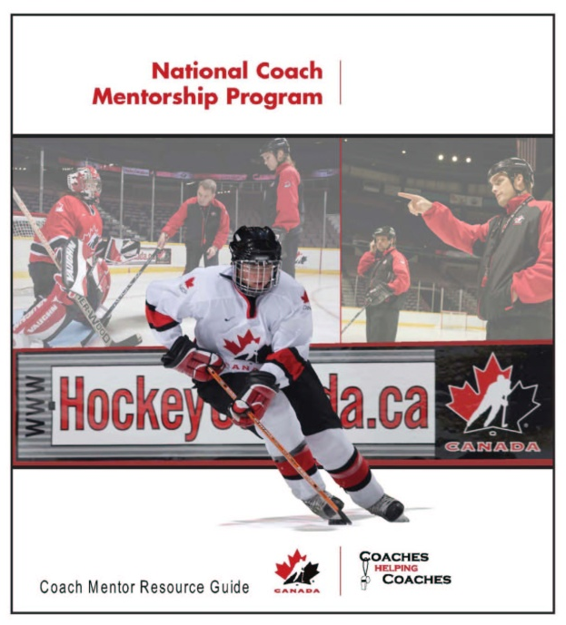
Programming Goals – MHA Centered
The most important aspects of Minor Hockey Association development are:
1) Consistency in the coaching philosophy
2) Consistency in what the coaches are teaching.

Slide 25
Programming Goals – MHA Centered
A Minor Hockey Association’s success from a coaching / player standpoint will be based on 3 main aspects:
Enjoyment of players coming to the rink everyday
Improvement of players’ skills
Developing of players to play at the next level

Slide 26
Key Steps to Building a Programming Model
What is your ideal player?
Forwards
-Highly skilled, competitive, and intelligent on the ice.
-Agile on their skates north, south, east, west
-Creative – willing to try things
Defence
-Willing to try and make a play
-Good passers, quick thinkers and agile skaters
Goaltenders
-Makes the saves they need to
-Technically sound and athletic
Regardless of what the ”ideal player” is, the MHA and the coaches have to be on the same page as far as what and how to develop it.

Slide 27
Key Steps to Building a Programming Model
By implementing a standardized technical curriculum and methodology for instruction, your association is building a foundation for athletes to enjoy the game of hockey and reach their potential. While it should be the goal of each team to be successful in their league, the player development process should be at the forefront of each team and this development component must not be compromised.

Slide 28
FC Barcelona – Proof of a System
In an era when all too many leading professional football clubs favor the “quick fix” approach to squad-building – the philosophy of FC Barcelona can sometimes seems like the rationale of a bygone age.
While other sides spend their cash in an effort to secure the best players, Barça continue to place heavy emphasis on a development program which has succeeded in carrying a remarkable number of boyhood talents all the way to the Barcelona first team and beyond.
Although many other top clubs have long-established youth set-ups, none in recent times has been able to match the success rate of Barça’s La Masia academy.

Slide 29
FC Barcelona – Proof of a System
FIFA Ballon d’Or - Messi, Iniesta and Xavi (the first time ever that the world’s best player award had been contested by three graduates of the same youth program), the academy’s incredible level of achievement was also clear for all to see during Spain’s successful 2010 FIFA World Cup South Africa™ campaign.
Seven graduates of La Masia were part of Spain’s World Cup-winning side in South Africa - six of them in the starting 11.
“It is not a specific objective, but we do aim to have as many players as possible from the academy reaching the highest level

Slide 30
FC Barcelona – Proof of a System
While the number of La Masia graduates is perhaps the most striking indication of Barça’s success, effectiveness in honing raw talent of the young athletes is the key behind the scenes.
Now that Barcelona are reaping the rewards from their long-term investment in youth, there is unsurprisingly plenty of talk about other clubs wanting to copy the methods and philosophies of La Masia.
“Most teams always rely on the first team coach, on the president. The changes that take place in clubs every two or three years mean that ideas change, but Barça has always maintained the same philosophy for youth football and that’s the main difference between us and other clubs. That’s the key to our success.”

Slide 31
FC Barcelona – Proof of a System
Decades of investment
La Masia’s success has not developed overnight, but is instead the result of more than three decades of ambitious youth football development by the club.
The philosophy of believing in youth players and weaning them on a doctrine of short passing and possession play was literally a foreign concept when it was introduced to the club in the 1970s.
What has been important over the years, is the manner in which the youth academy has been forced to mirror the prevailing strategies and formations of the Barcelona first team.

Slide 32
FC Barcelona – Proof of a System
The style of possession play was introduced systematically at the same time the same philosophy was applied to the youth teams – everyone is currently trained in the skills, tactics and philosophy of the current 4-3-3,”
While members of the coaching staff continued to follow Michels’ approach, it was Cruyff who decided that all the Barcelona teams would play in the same way to facilitate the transition to consistency

Slide 33
FC Barcelona – Proof of a System
“We take great pride and satisfaction in what’s happening at the moment,” this is down to the work of a lot of people who stuck with the same approach for many years to get to this great moment, where the three best players in the world are graduates of our youth academy.”
“For Barcelona to have the three FIFA Ballon d’Or finalists within the squad demonstrates the club’s excellence as an institution. Of course, Barcelona are admired for their success, but the social and sporting recognition which the club enjoys goes beyond simply winning matches. It has do with the footballing model we project, showing that you can be competitive and win, but also make it enjoyable for the spectators.

Slide 34
Key Steps to Building a Programming Model
Use the resources on the following pages to help support your coaches, and provide them with all of the tools necessary to develop their players

Slide 35

Resources / Programs
Skills Manuals
Skills of Gold DVD’s
Coach Mentorship
Specialty Clinics
Drill Packs
Program of Excellence
Skills Development Camps

Slide 36
Long Term Player Development
-Integrated into Hockey Canada Skills Development Manuals starting in 1996
-Skills Development Manuals available for all ages since 1999.
-Each manual contains 32 Practice Plans that progress from simple to more complex
-Initiation - Novice - Atom
-Peewee - Bantam - Midget
-Half Ice - Goaltending

Slide 37

Resources / Programs
A series of Specialty Clinics have been developed to offer coaches a practical session on teaching various skills, tactics & systems. This proactive approach will also open the doors of communication for coaches to further pursue a mentor.
The Specialty Clinic modules include:
  Skating
  Puck Control
  Small Area Games
  Checking
  Developing Defencemen
  Shooting & Scoring

Slide 38
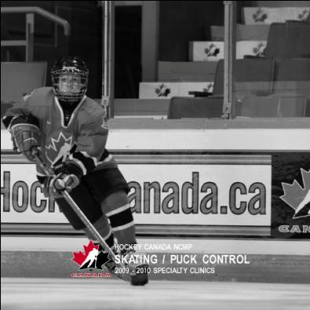
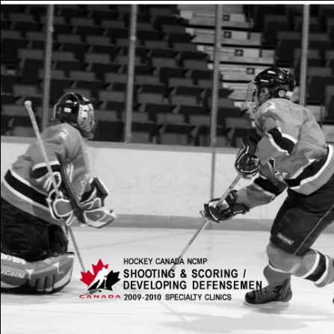
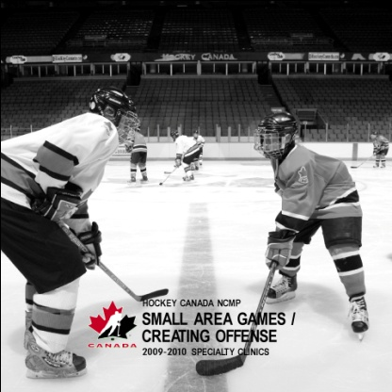
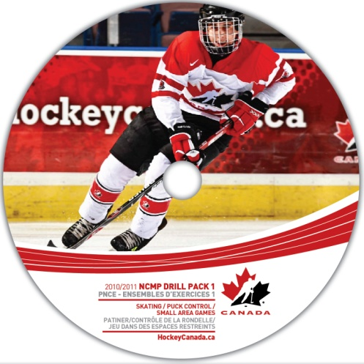

Resources / Programs

