Slide 1
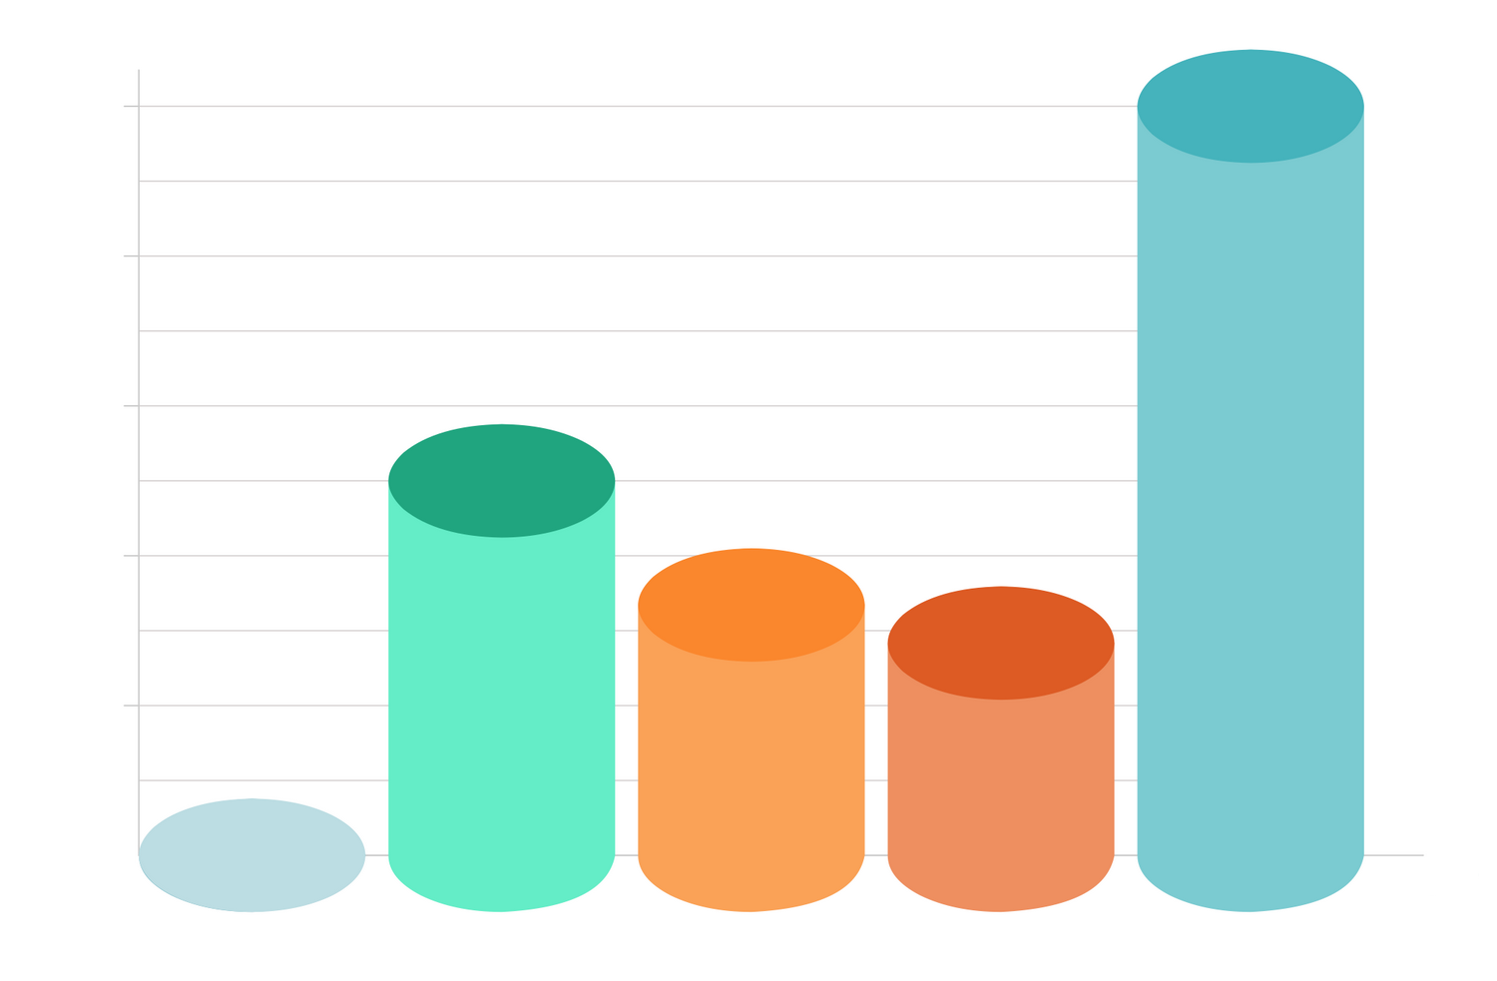
Title of Your Poster Goes Here and May Continue to Line 2 and Line 3 if Necessary
Example Name Here, DO, PhD
Example Name Here, DO, PhD
Example Name Here, DO, PhD
Kansas City University
Kansas City University
Kansas City University
Verdana
Large Headline is 66 pt
Suggested Chart/Table Styles
Suggested Chart/Table Styles
This is a 30 point font size. It is a good body text size font that can be read from approximately 6 ft. away. You can use font sizes as low as 24 point but it will be difficult to read from a distance. If you are presenting from a stage, simplify the message and enlarge the fonts. If you are presenting where the reader can walk up in front of your poster, smaller fonts are fine.
Suggested Chart/Table Styles
Verdana
Small Headline is 44 pt
Suggested Chart/Table Styles
This is a 24 point font size. It is a good medium size font that can be read from a short distance, less than 6 ft. You can use font sizes as low as 20 point but it will be difficult to read. If you are presenting from a stage, simplify the message and enlarge the fonts. If you are presenting where the reader can walk up in front of your poster, smaller fonts are fine.
Suggested Chart/Table Styles
Suggested Chart/Table Styles
Use High-Quality Images
Preferred Colors
Purple
RGB 75.48.72
Orange
RGB 209.65.36
Suggested Chart/Table Styles
Grey
RGB 200.201.199
Data 1-1
Data 1-2
Data 1-3
Data 1-4
Data 1-5
Data 1-6
Data 1-7
Data 2-1
Data 2-2
Data 2-3
Data 2-4
Data 2-5
Data 2-6
Data 2-7
Data 3-1
Data 3-2
Data 3-3
Data 3-4
Data 3-5
Data 3-6
Data 3-7
Lavender
RGB 153.145.164
Dark Grey
RGB 75.79.84
Notes:
Instructions Below (Click the Notes Button at Bottom of Screen to Hide):
Five steps are provided below to assist you with creating your poster. This template format is provided as a general layout and size. Please try to maintain as much of the template appearance as possible. Do not alter the banner colors, and do not skew the logo in any way. Font sizes, colors, and chart/table styles are provided as a guide and can be deleted or modified as needed.
NOTE: When the poster is saved as a PDF in Step 4 below, the extra width on the upper and lower banners will disappear. This width is intentional so the colors will bleed correctly during printing.
STEP 1) Save Template to Your Computer
From the PowerPoint ribbon, click the File Tab > Save As… Choose a location and create a file name, then click Save.
STEP 2) Adjust Page Size if Needed
This poster template is 48”h x 36”w. The poster size can be adjusted based on your requirements. From the PowerPoint ribbon, click the Design Tab > Slide Size. Adjust the height/width to your requirements. NOTE: PowerPoint will accept a dimension up to 56” in either direction. If your final poster needs to be larger than 56”, adjust both dimensions to 50% of your final product size and then request that your printing vendor print the file at 200%.
STEP 3) Add Your Content
All page elements should be edited in Normal View (View Tab > Normal). Poster template elements may be moved or deleted. Changing the background slide elements (logo, banner size, footer, etc.) is discouraged, but these elements can be accessed from the PowerPoint ribbon by clicking the View Tab > Slide Master. Close the Master View and return to Normal View to continue editing content.
STEP 4) Save as PDF
From the PowerPoint ribbon, click the File Tab > Save As… Choose a location and create a file name. From the Save As Type… dropdown menu, select PDF and then click Save.
STEP 5) Verify Clarity and Layout
Before sending to the print vendor, open the PDF version of your poster on your computer. If you will be printing your poster at 100%, zoom the PDF file to 100% and check to make sure all graphics and elements are clear without distortion. If you will be printing at 200%, zoom the PDF to 200% and check for clarity.

