Slide 1
2025 Residency Placement Data
Department of Career and Residency Placement Advising

Slide 2
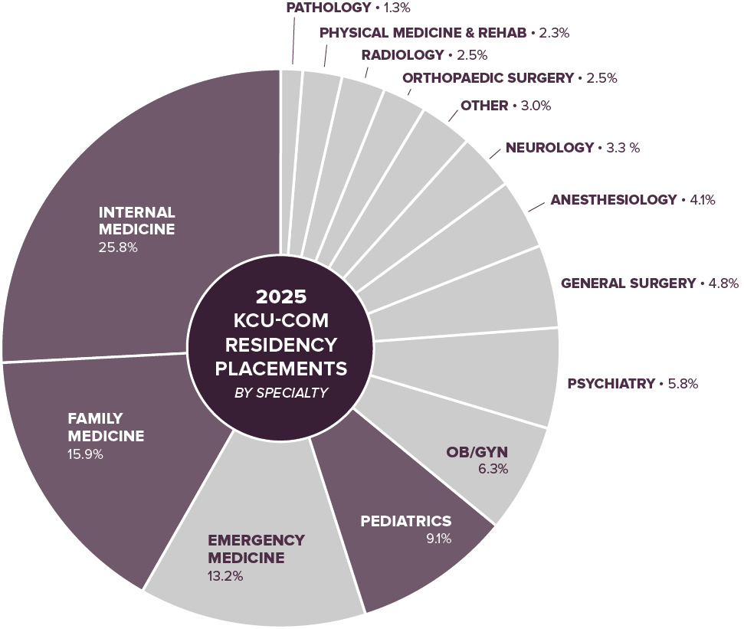
COM 2025
Placement Information
417 graduates
Placement Rate 99.3%
48.2% Primary Care
9.1% staying in Missouri

Slide 3
COM 2025 Placement Results
RESULTS | # of Students | % of Total
Categorical & M-Primary |  | 88.49%
AUA | 2
Military | 5
NRMP & SOAP | 358
Post SOAP | 4
Transitional/Preliminary Only (PGY1) |  | 4.32%
Military | 3
NRMP & SOAP | 15
Preliminary (PGY1) and Advanced (PGY2) |  | 6.23%
Military | 1
NRMP & SOAP | 22
Pre-Match & SOAP | 1
SF Match | 1
SF Match & NRMP | 1
Total Placed |  | 99.04%
Research | 1 | .24%
Not Placed | 3 | .72%
Grand Total |  | 100%

Slide 4
2025 Specialty Placement Outcomes
Total Categorical and Advanced Specialty Students: 395
Specialty | # of Students | % of Total |  | Specialty | # of Students | % of Total
Anesthesiology | 16 | 3.8% |  | Ophthalmology | 2 | .5%
Child Neurology | 1 | .2% |  | Orthopaedic Surgery | 10 | 2.4%
Dermatology | 3 | .7% |  | Otolaryngology | 3 | .7%
Emergency Medicine | 52 | 12.5% |  | Pathology | 5 | 1.2%
Family Medicine | 63 | 15% |  | Pediatrics | 33 | 7.9%
Internal Medicine * | 102 | 24.5% |  | Physical Medicine & Rehabilitation | 9 | 2.2%
Internal Medicine/Pediatrics | 3 | .7% |  | Psychiatry | 23 | 5.5%
Interventional Radiology | 1 | .2% |  | Radiation Oncology | 1 | .2%
Neurology | 12 | 2.9% |  | Radiology – Diagnostic | 9 | 2.2%
Obstetrics & Gynecology | 25 | 6% |  | Surgery - General | 19 | 4.5%
Occupational & Environmental Medicine | 1 | .2% |  | Urology | 2 | .5%
* Includes M - Primary
Notes:
Angie

Slide 5
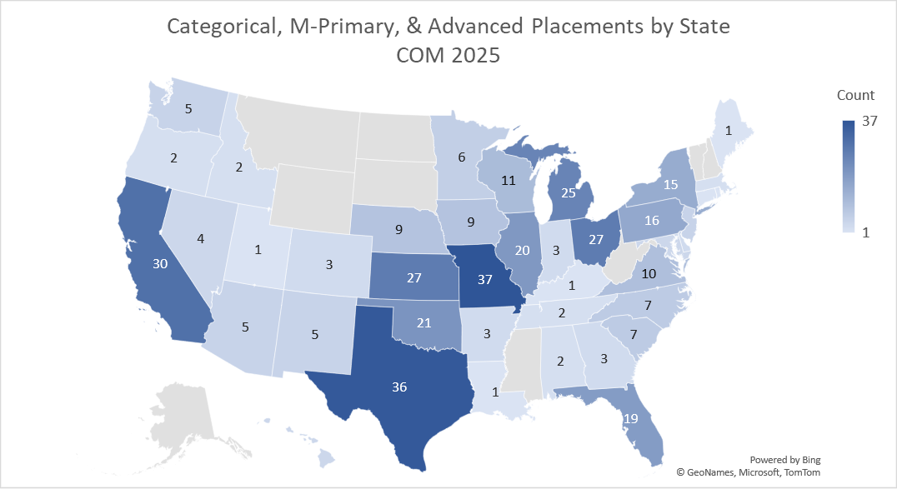
4
Notes:
Angie

Slide 6
2025 Anesthesiology Placements
Institution Name | City | State | # of Students
U Colarado SOM | Aurora | CO | 1
U Iowa Hospitals & Clinics | Iowa City | IA | 2
Loyola Univ Med Ctr-IL | Maywood | IL | 3
Maine Med Ctr | Portland | ME | 1
Univ of Missouri-KC Programs | Kansas City | MO | 1
University Hosps-Columbia-MO | Columbia | MO | 1
Duke Univ Med Ctr-NC | Durham | NC | 1
Cleveland Clinic Fdn-OH | Cleveland | OH | 1
OhioHealth-Doctors Hosp | Columbus | OH | 1
U Oklahoma COM-OK City | Oklahoma City | OK | 1
Temple Univ Hosp-PA | Philadelphia | PA | 1
Mary Washington Healthcare-VA | Fredericksburg | VA | 1
U Wisconsin Hospital and Clinics | Madison | WI | 1

Slide 7
2025 Child Neurology Placements
Institution Name | City | State | # of Students
UC Irvine Med Ctr-CA | Orange | CA | 1

Slide 8
2025 Dermatology Placements
Institution Name | City | State | # of Students
HCA Florida Orange Park Hosp | Orange Park | FL | 1
Larkin Comm Hosp Springs Campus-FL | Hialeah | FL | 1
St. John's Episcopal Hospital-South Shore Program | Far Rockaway | NY | 1

Slide 9
2025 Emergency Medicine Placements
Institution Name | City | State | # of Students
Creighton University-AZ | Phoenix | AZ | 1
Desert Regional Med Ctr-CA | Palm Springs | CA | 2
Kaiser Permanente-Central Valley-CA | Modesto | CA | 1
Kaweah Delta Health Care District-CA | Visalia | CA | 1
St Agnes Med Ctr-CA | Fresno | CA | 1
Sutter Health-CA | Roseville | CA | 1
SW Healthcare Med Ed Consortium-CA | Temecula | CA | 1
HCA Healthcare East FL Division GME | Aventura | FL | 1
U Central FL/HCA Healthcare GME | Gainesville | FL | 1
Central Iowa Health System | Des Moines | IA | 2
Rush University Med Ctr-IL | Chicago | IL | 2
U Illinois COM-Chicago | Chicago | IL | 1
U Kansas SOM-Kansas City | Kansas City | KS | 6
Johns Hopkins Hospital | Baltimore | MD | 1
Corewell Health Lakeland-MI | Saint Joseph | MI | 1
Corewell Health-MI | Farmington Hills | MI | 1
Corewell Health-MI | Trenton | MI | 1

Slide 10
2025 Emergency Medicine Placements - continued
Institution Name | City | State | # of Students
Henry Ford Jackson Hospital-MI | Jackson | MI | 1
KCU-GME Consortium-MO | Joplin | MO | 1
Univ of Missouri-KC Programs | Kansas City | MO | 2
University of Nebraska Med Ctr | Omaha | NE | 2
Jefferson Health New Jersey | Stratford | NJ | 1
Garnet Health Med Ctr-NY | Middletown | NY | 1
Maimonides Med Ctr-NY | Brooklyn | NY | 1
St Barnabas Hosp-NY | Bronx | NY | 1
SUNY HSC Brooklyn-NY | Brooklyn | NY | 1
Akron General Med Ctr-OH | Akron | OH | 1
Aultman Hospital/NEOMED-OH | Canton | OH | 1
Case Western/Univ Hosps Cleveland Med Ctr-OH | Cleveland | OH | 1
Integris Health-OK | Oklahoma City | OK | 1
Oklahoma State U Ctr for Health Sci | Norman | OK | 1
U Oklahoma COM-Tulsa | Tulsa | OK | 1
JHME-Jefferson Einstein Philadelphia-PA | Philadelphia | PA | 2
St Lukes Hosp-Bethlehem-PA | Bethlehem | PA | 1

Slide 11
2025 Emergency Medicine Placements - continued
Institution Name | City | State | # of Students
Prisma Health-U of SC SOM Columbia | Columbia | SC | 1
Texas Tech U Affil-Lubbock | Lubbock | TX | 1
U Texas at Austin Dell Medical School | Austin | TX | 1
U Texas Med Branch-Galveston | Galveston | TX | 1
EVMS Old Dominion University-VA | Norfolk | VA | 1
Navy Medical Center | Portsmouth | VA | 1
U Wisconsin Hospital and Clinics | Madison | WI | 1

Slide 12
2025 Family Medicine Placements
Institution Name | City | State | # of Students
U South Alabama Hospitals | Mobile | AL | 1
Baptist Health-AR | North Little Rock | AR | 1
Adventist Health White Memorial | Los Angeles | CA | 1
Morehouse Sch of Med-GA | Santa Cruz | CA | 1
Sutter Health-CA | Sacramento | CA | 2
St Joseph Hospital SCL Health-CO | Denver | CO | 1
Northeast Georgia Med Ctr | Gainesville | GA | 1
Hilo Medical Center-HI | Hilo | HI | 1
Genesis Quad Cities-IA | Davenport | IA | 1
Eastern Idaho Reg Med Ctr | Idaho Falls | ID | 1
Hinsdale Hospital-IL | Hinsdale | IL | 2
Northwestern McGaw/NMH/VA-IL | Geneva | IL | 1
U Illinois COM-Peoria OSF | Peoria | IL | 1
Ascension St Vincent Hosp-IN | Indianapolis | IN | 1
Memorial Hospital-IN | South Bend | IN | 1
U Kansas SOM-Kansas City | Kansas City | KS | 1
U Kansas SOM-Kansas City | Olathe | KS | 1

Slide 13
2025 Family Medicine Placements - continued
Institution Name | City | State | # of Students
U Kansas SOM-Wichita | Wichita | KS | 3
Meritus Medical Center-MD | Hagerstown | MD | 1
Henry Ford Hospital-MI | Detroit | MI | 1
Allina Health-MN | St Paul | MN | 1
U Minnesota Med School | St Paul | MN | 1
CoxHealth-MO | Springfield | MO | 1
HCA Healthcare Kansas City-MO | Kansas City | MO | 3
HCA Healthcare Kansas City-MO | Lee Summit | MO | 1
Mercy Hospital St Louis-MO | St Louis | MO | 1
SSM Health/St Louis Univ SOM-MO | St Louis | MO | 1
SW Missouri Consortium GME | Springfield | MO | 2
Novant Health-NC | Cornelius | NC | 1
Clarkson Family Med Res-NE | Omaha | NE | 1
Virtua Health | Voorhees | NJ | 1
U New Mexico SOM | Albuquerque | NM | 1
Nellis Air Force Base | Las Vegas | NV | 1
Christ Hospital-OH | Cincinnati | OH | 1

Slide 14
2025 Family Medicine Placements - continued
Institution Name | City | State | # of Students
Kettering Health Network-OH | Dayton | OH | 1
The MetroHealth Sys/Case Western-OH | Cleveland | OH | 1
In His Image Family Med-OK | Tulsa | OK | 1
Oklahoma State University Center for Health Sciences | McAlester | OK | 1
OMECO-OK | Tahlequah | OK | 1
OMECO-OK | Tulsa | OK | 1
Oregon Health & Science Univ | Hillsboro | OR | 1
University of Pennsylvania Health System Program | Springfield | PA | 1
UPMC Presbyterian Shadyside-PA | Pittsburgh | PA | 1
Campbell University-NC | Conway | SC | 1
CHRISTUS Health-TX | Corpus Christi | TX | 1
Texas Tech U Affil-Amarillo | Amarillo | TX | 2
Texas Tech U Affil-Lubbock | Lubbock | TX | 1
U Texas Southwestern Med Sch-Dallas | Dallas | TX | 1
HCA Healthcare LGH-Montgomery/VCOM-VA | Blacksburg | VA | 1
MultiCare Health System-WA | Puyallup | WA | 1
Virginia Mason Franciscan Health-WA | Bremerton | WA | 1
Aurora St Lukes Medical Ctr-WI | Milwaukee | WI | 1

Slide 15
2025 Family Medicine Placements - continued
Institution Name | City | State | # of Students
U Wisconsin SOM and Public Health | Madison | WI | 1
WiNC GME Consortium-WI | Appleton | WI | 1
WiNC GME Consortium-WI | Wausau | WI | 1

Slide 16
2025 Internal Medicine Placements
Institution Name | City | State | # of Students
U South Alabama Hospitals | Mobile | AL | 1
U Arkansas COM-Little Rock | Little Rock | AR | 1
Midwestern University OPTI-AZ | Mesa | AZ | 2
Community Mem Health Sys-CA | Ventura | CA | 1
Santa Clara Valley Med Ctr-CA | San Jose | CA | 1
Scripps Clinic/Green Hospital-CA | La Jolla | CA | 1
St Josephs Med Ctr-CA | Stockton | CA | 1
Sutter Health-CA | Oakland | CA | 2
SW Healthcare Med Ed Consortium-CA | Temecula | CA | 1
UC Riverside SOM-CA | San Bernardino | CA | 1
UC San Francisco-Fresno-CA | Fresno | CA | 2
U Colorado SOM-Denver | Denver | CO | 1
Nuvance Health Consortium-NY | Norwalk | CT | 1
Cleveland Clinic Florida | Weston | FL | 1
Florida State University COM | Cape Coral | FL | 1
HCA Florida JFK Hosp-U Miami-FL | Atlantis | FL | 2
HCA Healthcare/USF Morsani GME | Largo | FL | 1

Slide 17
2025 Internal Medicine Placements - continued
Institution Name | City | State | # of Students
HCA Healthcare/USF Morsani GME-Oak Hill-FL | Brooksville | FL | 1
Mayo Clinic School of Grad Med Educ-FL | Jacksonville | FL | 1
U Miami/Jackson Health System-FL | Miami | FL | 1
Kaiser Permanente Hawaii | Honolulu | HI | 1
University of Hawaii | Honolulu | HI | 1
Central Iowa Health System | Des Moines | IA | 1
U Washington Boise-ID | Boise | ID | 1
Loyola Univ Med Ctr-IL | Maywood | IL | 1
Mercyhealth GME Consortium-IL | Rockford | IL | 1
HCA Healthcare Kansas City-MO | Overland Park | KS | 1
U Kansas SOM-Kansas City | Kansas City | KS | 1
U Kansas SOM-Kansas City | Olathe | KS | 1
U Kansas SOM-Wichita | Wichita | KS | 2
Ochsner Clinic Foundation-LA | New Orleans | LA | 1
Corewell Health-MI | Farmington Hills | MI | 2
Henry Ford Genesys Hospital-MI | Grand Blanc | MI | 1
McLaren Health Care Corp-MI | Lansing | MI | 1

Slide 18
2025 Internal Medicine Placements - continued
Institution Name | City | State | # of Students
Trinity Health Ann Arbor Hosp-MI | Ann Arbor | MI | 1
U Michigan Health-West | Wyoming | MI | 1
Western Michigan Univ Stryker SOM | Kalamazoo | MI | 1
U Minnesota Med School | Minneapolis | MN | 2
HCA Healthcare Kansas City-MO | Independence | MO | 3
KCU-GME Consortium-MO | Joplin | MO | 2
University Hosps-Columbia-MO | Columbia | MO | 4
Creighton University-NE | Omaha | NE | 4
New York-Presbyterian/Queens | Flushing | NY | 1
Stony Brook Teach Hosps-NY | Stony Brook | NY | 1
University at Buffalo SOM-NY | Buffalo | NY | 1
Adena Health System | Chillicothe | OH | 1
Case Western/Univ Hosps Cleveland Med Ctr-OH | Cleveland | OH | 1
Kettering Health Network-OH | Dayton | OH | 1
Mercy Health Fairfield Hospital | Fairfield | OH | 1
OhioHealth-Doctors Hosp | Columbus | OH | 2
OhioHealth-Riverside Methodist | Columbus | OH | 1

Slide 19
2025 Internal Medicine Placements - continued
Institution Name | City | State | # of Students
Western Reserve Hosp-OH | Cuyahoga Falls | OH | 1
Wright State Univ Boonshoft SOM-OH | Dayton | OH | 2
Oklahoma State U Ctr for Health Sci | Tulsa | OK | 1
U Oklahoma COM-OK City | Oklahoma City | OK | 1
U Oklahoma COM-Tulsa | Tulsa | OK | 1
Legacy Emanuel/Good Samaritan-OR | Portland | OR | 1
JHME-Jefferson Einstein Montgomery-PA | East Norriton | PA | 1
Brown Univ/Kent Hospital | Warwick | RI | 1
Baylor S&W All Saints Med Ctr-TX | Fort Worth | TX | 1
Baylor S&W-Baylor COM Temple-TX | Temple | TX | 2
CHRISTUS Health-TX | Longview | TX | 2
HCA Medical City Healthcare-TX | Arlington | TX | 1
Methodist Healthcare Sys-San Antonio | San Antonio | TX | 1
Texas Health Resources | Bedford | TX | 3
Texas Health Resources | Fort Worth | TX | 1
U Texas Med Branch-Galveston | Galveston | TX | 4
U Texas Med Sch-Houston | Houston | TX | 1

Slide 20
2025 Internal Medicine Placements - continued
Institution Name | City | State | # of Students
Johnston Memorial Hospital | Abingdon | VA | 2
Elson S Floyd COM WSU-WA | Spokane | WA | 1
Madigan Army Medical Center | Tacoma | WA | 1
Spokane Teaching Health Ctr-WA | Spokane | WA | 1

Slide 21
2025 Internal Medicine - Primary Placements
Institution Name | City | State | # of Students
Alameda Health Sys-Highland Hosp-CA | Oakland | CA | 1
Mercy Med Ctr-Des Moines-IA | Des Moines | IA | 1
U Kentucky Med Ctr | Lexington | KY | 1
TIGMER-TX | Laredo | TX | 1

Slide 22
2025 Internal Medicine - Pediatrics Placement
Institution Name | City | State | # of Students
U Arizona COM-Phoenix | Phoenix | AZ | 1
Geisinger Health System-PA | Danville | PA | 1
Med Coll Wisconsin Affil Hosps | Milwaukee | WI | 1

Slide 23
2025 Interventional Radiology (Integ) Placement
Institution Name | City | State | # of Students
Medical University of SC | Charleston | SC | 1

Slide 24
2025 Medicine - Preliminary Placements
Institution Name | City | State | # of Students
Creighton University | Phoenix | AZ | 1
Advocate Health Care-IL | Park Ridge | IL | 2
U Kansas SOM-Kansas City | Kansas City | KS | 3
Rutgers-Newark Beth Israel Med Ctr-NJ | Newark | NJ | 1
Baylor S&W-Baylor COM Temple-TX | Temple | TX | 1
Eastern Virginia MS at Old Dominion University | Norfolk | VA | 1

Slide 25
2025 Neurology Placements
Institution Name | City | State | # of Students
U Illinois COM-Chicago | Chicago | IL | 1
Corewell Health-MI | Farmington Hills | MI | 1
Detroit Med Ctr/WSU-MI | Detroit | MI | 1
Henry Ford Hospital-MI | Detroit | MI | 1
U Minnesota Med School | Minneapolis | MN | 1
Rutgers-R W Johnson Medical School-NJ | New Brunswick | NJ | 1
Cleveland Clinic Fdn-OH | Cleveland | OH | 1
Kettering Health Network-OH | Dayton | OH | 1
St Lukes Hosp-Anderson-PA | Easton | PA | 1
Tower Health/Reading Hospital-PA | West Reading | PA | 1
UPMC Medical Education-PA | Pittsburgh | PA | 1
Prisma Health-U of SC SOM Greenville | Greer | SC | 1

Slide 26
2025 Obstetrics & Gynecology Placements
Institution Name | City | State | # of Students
HCA Healthcare/USF Morsani GME-Brandon-FL | Brandon | FL | 1
Orlando Health-FL | Orlando | FL | 1
U Illinois COM-Peoria OSF | Peoria | IL | 1
HCA Healthcare Kansas City-MO | Overland Park | KS | 1
U Kansas SOM-Wichita | Wichita | KS | 3
UMass Chan Medical School-MA | Worcester | MA | 1
Henry Ford Providence Hosp-MI | Southfield | MI | 1
Henry Ford Warren Hosp-MI | Warren | MI | 1
SSM Health/St Louis Univ SOM-MO | St Louis | MO | 1
Creighton University-NE | Omaha | NE | 1
Flushing Hospital Med Ctr-NY | Flushing | NY | 1
NYP Brooklyn Methodist Hosp-NY | Brooklyn | NY | 1
Rochester Gen Hosp-NY | Rochester | NY | 1
University at Buffalo SOM-NY | Buffalo | NY | 1
Akron General Med Ctr-OH | Akron | OH | 1
OMECO-OK | Tulsa | OK | 2
St Anthony Hospital-OK | Oklahoma City | OK | 1

Slide 27
2025 Obstetrics & Gynecology Placements - continued
Institution Name | City | State | # of Students
Tower Health/Reading Hospital-PA | Reading | PA | 1
UPMC Harrisburg-PA | Harrisburg | PA | 1
Methodist Health System Dallas-TX | Dallas | TX | 1
Texas Tech U Affil-Amarillo | Amarillo | TX | 1
Inova Fairfax Hospital-VA | Falls Church | VA | 1

Slide 28
2025 Occupational & Environmental Med Placement
Institution Name | City | State | # of Students
U Texas HSC-Tyler | Tyler | TX | 1

Slide 29
2025 Ophthalmology Placements
Institution Name | City | State | # of Students
University of Minnesota | Minneapolis | MN | 1
Eastern Virginia MS at Old Dominion University | Norfolk | VA | 1

Slide 30
2025 Orthopaedic Surgery Placements
Institution Name | City | State | # of Students
UC San Francisco-Fresno-CA | Fresno | CA | 1
Henry Ford Genesys Hospital-MI | Grand Blanc | MI | 1
Henry Ford Macomb Hospital-MI | Clinton Township | MI | 1
KCU-GME Consortium-MO | Kansas City | MO | 2
University Hosps-Columbia-MO | Columbia | MO | 1
Rutgers-Jersey City Med Ctr-NJ | Jersey City | NJ | 1
Valley Hosp Med Ctr-NV | Las Vegas | NV | 1
Zucker SOM-Northwell Huntington Hosp-NY | Huntington | NY | 1
OhioHealth-Doctors Hosp | Columbus | OH | 1

Slide 31
2025 Otolaryngology Placement
Institution Name | City | State | # of Students
Detroit Med Ctr/WSU-MI | Detroit | MI | 1
KCU-GME Consortium-MO | Joplin | MO | 1
Oklahoma State U Ctr for Health Sci | Tulsa | OK | 1

Slide 32
2025 Pathology Placements
Institution Name | City | State | # of Students
Loyola Univ Med Ctr-IL | Maywood | IL | 1
U Kansas SOM-Kansas City | Kansas City | KS | 1
Corewell Health-MI | Royal Oak | MI | 1
UPMC Medical Education-PA | Pittsburgh | PA | 1
University of Utah Health | Salt Lake City | UT | 1

Slide 33
2025 Pediatrics Placements
Institution Name | City | State | # of Students
UCLA Med Ctr-CA | Los Angeles | CA | 1
Valley Childrens Healthcare-CA | Madera | CA | 1
TJU/Nemours Childrens Health-PA | Wilmington | DE | 1
Orlando Health-FL | Orlando | FL | 1
Emory Univ SOM-GA | Atlanta | GA | 1
Medical College of Georgia | Augusta | GA | 1
Tripler Army Medical Center | Tripler AMC | HI | 1
Central Iowa Health System | Des Moines | IA | 1
U Iowa Hospitals & Clinics | Iowa City | IA | 1
Advocate Health Care-IL | Oak Lawn | IL | 2
Advocate Health Care-IL | Park Ridge | IL | 1
Childrens Mercy Hospital-MO | Kansas City | MO | 4
ECU Health Med Ctr-NC | Greenville | NC | 1
University of Nebraska Med Ctr | Omaha | NE | 1
U New Mexico SOM | Albuquerque | NM | 2
Akron Children's-OH | Akron | OH | 1
Case Western/Univ Hosps Cleveland Med Ctr-OH | Cleveland | OH | 2

Slide 34
2025 Pediatrics Placements - continued
Institution Name | City | State | # of Students
OMECO-OK | Tulsa | OK | 1
Prisma Health-U of SC SOM Greenville | Greenville | SC | 1
U Tennessee Health Sci Ctr-Memphis | Memphis | TN | 1
Baylor Coll Med-Houston-TX | San Antonio | TX | 1
U Texas at Austin Dell Medical School | Austin | TX | 1
U Texas Med Sch-Houston | Houston | TX | 1
EVMS Old Dominion University-VA | Norfolk | VA | 1
Marshfield Clinic-WI | Marshfield | WI | 1
Med Coll Wisconsin Affil Hosps | Milwaukee | WI | 2

Slide 35
2025 Physical Medicine & Rehabilitation Placements
Institution Name | City | State | # of Students
U Arkansas COM-Little Rock | Little Rock | AR | 1
Schwab Rehab Hosp-IL | Chicago | IL | 1
U Kansas SOM-Kansas City | Kansas City | KS | 2
Johns Hopkins Hospital | Baltimore | MD | 1
Detroit Med Ctr/WSU-MI | Detroit | MI | 1
U New Mexico SOM | Albuquerque | NM | 1
Good Samaritan Univ Hosp | Rockville Centre | NY | 1
Temple Univ Hosp-PA | Philadelphia | PA | 1

Slide 36
2025 Psychiatry Placements
Institution Name | City | State | # of Students
Kaiser Permanente-Oakland-CA | Oakland | CA | 1
Mission Community Hosp-CA | Panorama City | CA | 1
Christiana Care-DE | Wilmington | DE | 1
Broward Health Med Ctr-FL | Fort Lauderdale | FL | 1
HCA Healthcare East FL Division GME | Aventura | FL | 1
U Central FL/HCA Healthcare GME | Gainesville | FL | 1
U Central FL/HCA Healthcare GME | Kissimmee | FL | 1
University of Miami/Jackson Health System | Miami | FL | 1
U Kansas SOM-Kansas City | Kansas City | KS | 2
SSM Health/St Louis Univ SOM-MO | St Louis | MO | 2
Carolinas Med Ctr-NC | Milwaukee | NC | 1
New Hanover Reg Med Ctr-NC | Wilmington | NC | 1
U New Mexico SOM | Albuquerque | NM | 1
Maimonides Med Ctr-NY | Brooklyn | NY | 1
Ohio State University Med Ctr | Columbus | OH | 1
U Oklahoma COM-OK City | Oklahoma City | OK | 1
JHME-Jefferson Einstein Philadelphia-PA | Philadelphia | PA | 1

Slide 37
2025 Psychiatry Placements - continued
Institution Name | City | State | # of Students
Prisma Health-U of SC SOM Greenville | Greenville | SC | 1
Prisma Health-U of SC SOM Greenville | Greer | SC | 1
U Texas HSC-Tyler | Pittsburg | TX | 1
Carilion Clinic-Virginia Tech Carilion SOM | Roanoke | VA | 1

Slide 38
2025 Radiation Oncology Placements
Institution Name | City | State | # of Students
U Kansas SOM-Kansas City | Kansas City | KS | 1

Slide 39
2025 Radiology – Diagnostic Placements
Institution Name | City | State | # of Students
U Kansas SOM-Kansas City | Kansas City | KS | 1
Tufts Medical Center-MA | Boston | MA | 1
Univ of Missouri-KC Programs | Kansas City | MO | 1
Sunrise Health GME Consortium-NV | Las Vegas | NV | 1
Integris Health | Oklahoma City | OK | 2
U Oklahoma COM-OK City | Oklahoma City | OK | 1
Baylor S&W-Baylor COM Temple-TX | Temple | TX | 1
San Antonio Uniformed Services Health Education Consortium | San Antonio | TX | 1

Slide 40
2025 Surgery - General Placements
Institution Name | City | State | # of Students
HonorHealth-Phoenix | Phoenix | AZ | 1
Kern Med Ctr-CA | Bakersfield | CA | 1
UC San Francisco-Fresno-CA | Fresno | CA | 1
Christiana Care-DE | Newark | DE | 1
Franciscan Health Olympia Fields-IL | Olympia Fields | IL | 1
Ascension St Vincent Hosp-IN | Indianapolis | IN | 1
Sinai Hospital of Baltimore-MD | Baltimore | MD | 1
McLaren Health Care Corp-MI | Lansing | MI | 1
KCU-GME Consortium-MO | Blue Springs | MO | 1
Univ of Missouri-KC Programs | Kansas City | MO | 1
Cape Fear Valley Health-NC | Fayetteville | NC | 1
Womack Army Medical Center | Fort Liberty | NC | 1
Virtua Health-NJ | Camden | NJ | 1
Sunrise Health GME Consortium-NV | Las Vegas | NV | 1
Oklahoma State U Ctr for Health Sci | Tulsa | OK | 1
U Tennessee Health Sci Ctr-Memphis | Memphis | TN | 1
St Davids Healthcare GME-TX | Austin | TX | 1

Slide 41
2025 Surgery - General Placements - continued
Institution Name | City | State | # of Students
Texas Health Resources | Fort Worth | TX | 1
Gundersen Lutheran Med Fdn-WI | La Crosse | WI | 1

Slide 42
2025 Surgery - Preliminary Placements
Institution Name | City | State | # of Students
David Grant USAF Medical Center, Travis AFB | Fairfield | CA | 1
St Joseph Hospital SCL Health-CO | Denver | CO | 1
HCA Healthcare/USF Morsani-Bayonet Pt-FL | Hudson | FL | 2
Rush University Med Ctr | Chicago | IL | 1
Umass Chan - Baystate | Springfield | MA | 1
Univ of Missouri-KC Programs | Kansas City | MO | 1
New York-Presbyterian/Queens | Flushing | NY | 1
NYMC-Metropolitan Hosp Ctr-NY | New York | NY | 1
Jewish Hospital | Cincinnati | OH | 1
Penn State Hershey Med Ctr-PA | Hershey | PA | 1
Medical University of SC | Charleston | SC | 1
Texas Tech U Affil-Lubbock | Lubbock | TX | 1
U Texas HSC-San Antonio | San Antonio | TX | 1
U Texas Med Sch-Houston | Houston | TX | 1
Virginia Commonwealth U Hlth Sys | Richmond | VA | 1

Slide 43
2025 Transitional Year Placements
Institution Name | City | State | # of Students
David Grant USAF Medical Center, Travis AFB | Fairfield | CA | 1
Sutter Health-CA | Oakland | CA | 1
HCA Florida Orange Park Hosp | Orange Park | FL | 1
HCA Healthcare East FL Division GME | Fort Pierce | FL | 1
Lakeland Regional Health | Lakeland | FL | 2
Memorial Healthcare System-FL | Pembroke Pines | FL | 1
Eisenhower Army Medical Center | Fort Gordon | GA | 1
Detroit Med Ctr/WSU-MI | Detroit | MI | 1
Hennepin Co Med Ctr-MN | Minneapolis | MN | 1
Garnet Health Med Ctr-NY | Middletown | NY | 1
Nassau Univ Med Ctr-NY | East Meadow | NY | 1
OhioHealth-Riverside Methodist | Columbus | OH | 1
Mercy Catholic Med Ctr-PA | Darby | PA | 1
Lexington Medical Center | West Columbia | SC | 1
San Antonio Uniformed Services Health Education Consortium | San Antonio | TX | 1
U Texas HSC-Tyler | Tyler | TX | 2
Med Coll Wisconsin Affil Hosps | Milwaukee | WI | 1

Slide 44
2025 Urology Placements
Institution Name | City | State | # of Students
McLaren Health Care/Macomb/MSU Program | Mt. Clemens | MI | 1
University of Michigan Health - Sparrow Hospital | Lansing | MI | 1

