Slide 1

How to Apply to College

Slide 2




Agenda
Overview of the Ontario Colleges Website
Program Type
How to Apply
Key Dates to Remember

Slide 3

Get to know the Ontario Colleges Website

Slide 4
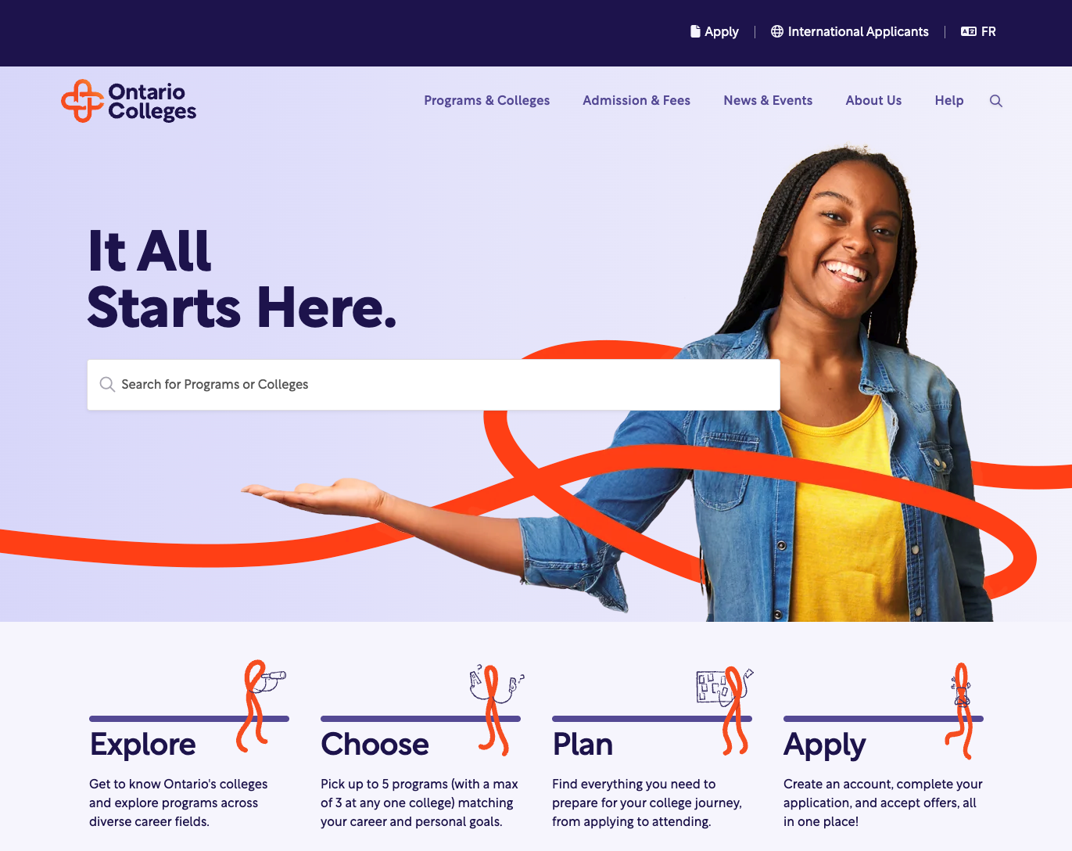
Website
Homepage:
Easily search for programs and colleges
4 Steps from Exploring to Applying
Announcements, blogs, and events

Slide 5
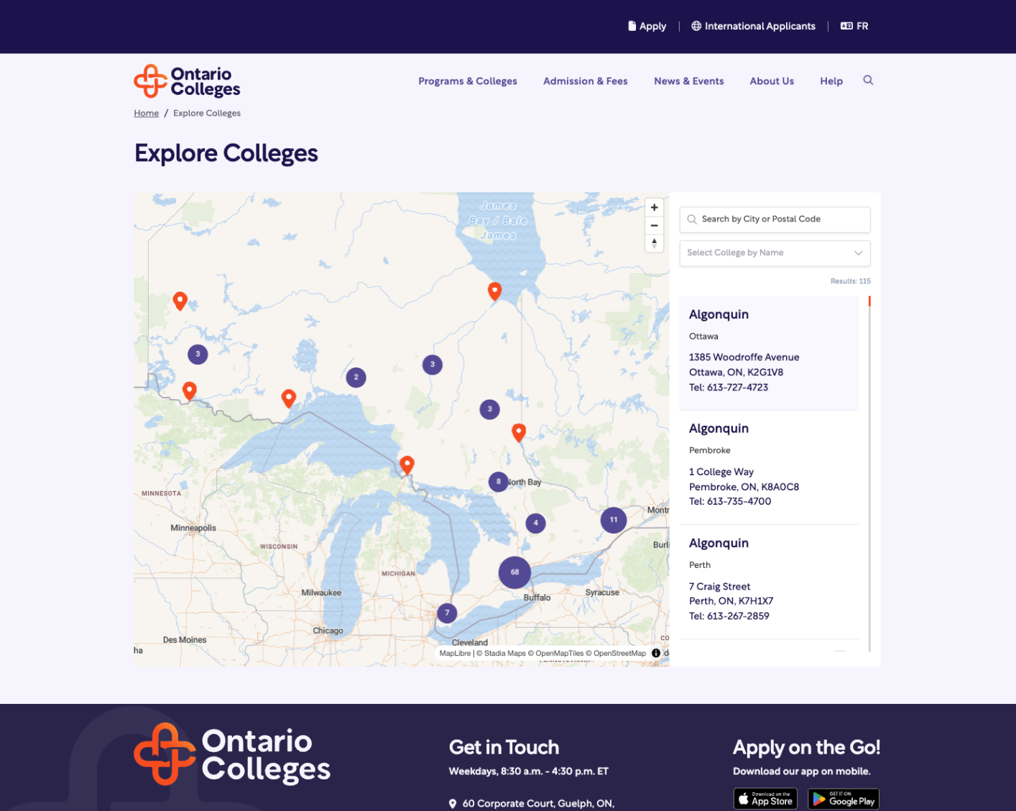

Website
Programs & Colleges:
Learn more about what makes each college unique!
View all college campuses with an interactive map
View programs offered at each college or each campus

Slide 6
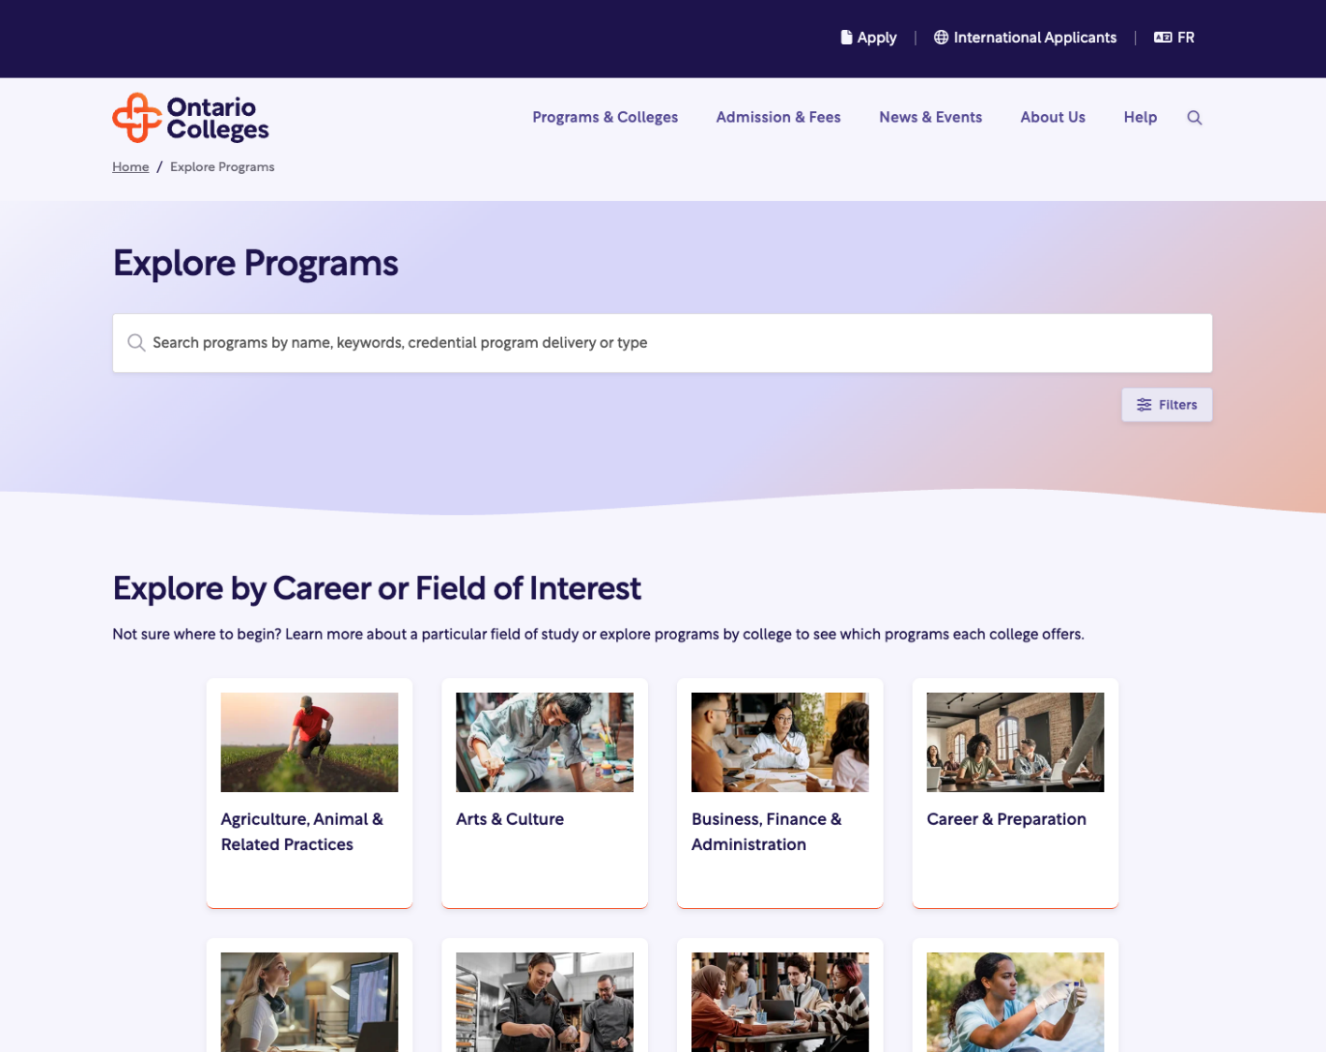
Website
Programs & Colleges:
Search for any program keyword
Explore programs by career or field of interest
Learn more about each career and the programs that lead to them.

Slide 7
Program Types

Slide 8



























Program Variety

Slide 9
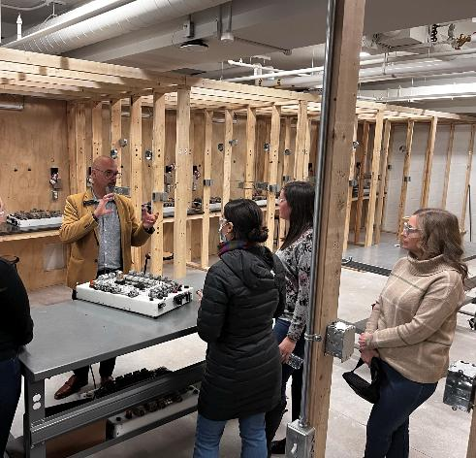

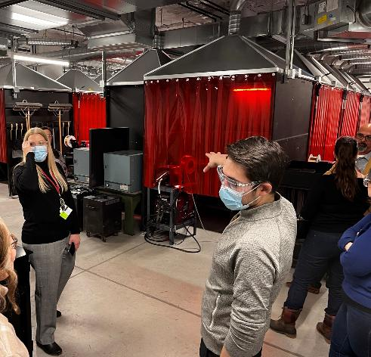
Skilled Trades Programs
By 2030, there will be 700,000 vacant trades jobs across Canada
Learn a trade in a classroom environment
Safe simulations
Help students find apprenticeships

Slide 10



Program Types
Certificates
Diplomas
Degrees
Certificate Programs
(1 year)
Graduate Certificate Programs (1 year)
Diploma Programs
(2 years)
Advanced Diploma Programs (3 years)
Degree Programs
(3 years)
Degree Programs (Honours) (4 years)
Collaborative Degree Programs (4 - 5 years)

Slide 11
Certificate Program Types
Key Takeaways
Certificate Programs
(1 year)
Graduate Certificate Programs
(1 year)
Quick
Get equipped with essential skills
Perfect to efficiently enter the workforce

Slide 12
Diploma Program Types
Key Takeaways
Diploma Programs
(2 years)
Advanced Diploma Programs
(3 years)
Helps you stand out
Often includes a
co-op or work placement
Positions you as industry-ready

Slide 13
Degree Program Types
Key Takeaways
Degree Programs (3 years)
Degree Programs (Honours) (4 years)
  Allows you to apply for Masters programs
Collaborative Degree Programs (4-5 years)
  A 4-year collaborative program typically costs less than a 4-year university program.
Blends theory and practical skills
Prepares you for real-world challenges
Graduate with a deep understanding of your subject

Slide 14
Ready to Apply?

Slide 15
Now is the best time to Apply!
Want to start college in September or January? Now is a great time to apply!
Application for September and January Intakes opens around October 1st
Includes up to 5 program choices (no more than 3 at any one college). No extra cost to make changes!

Slide 16
Summary of Important Dates
October: Application Opens
November 1: Earliest Offer Date
February 1: Equal Consideration Date
May 1: Deadline to Confirm Offer
June: Tuition Deposit Deadline

Slide 17

How to Apply Video
Link to YouTube Video

Slide 18
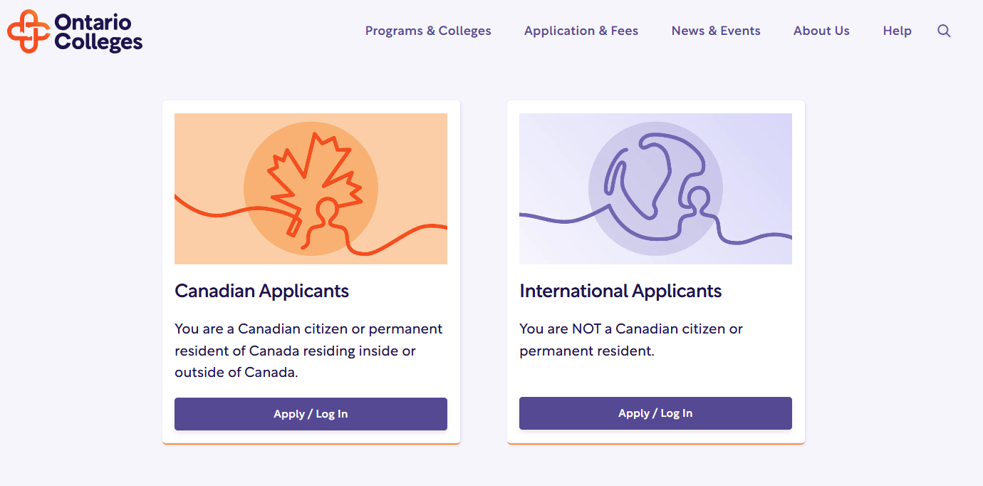
Application starts here!

Slide 19
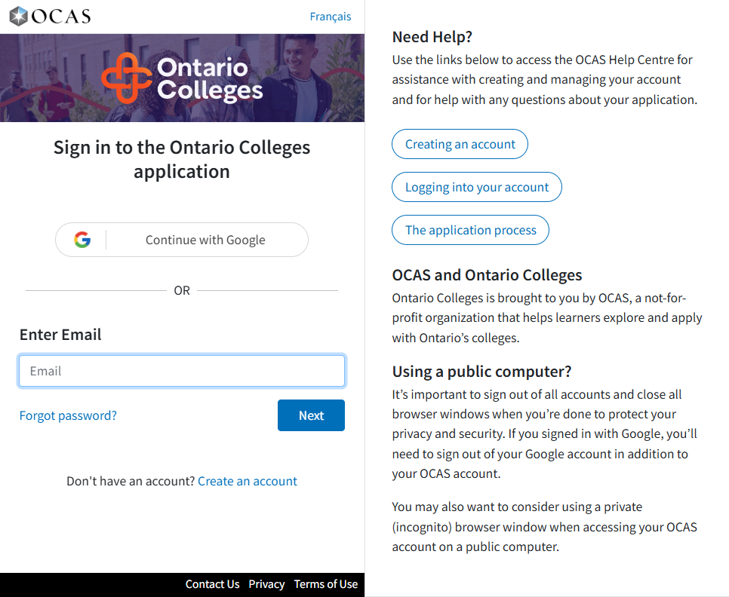
Sign up Options: Google or Email

Slide 20
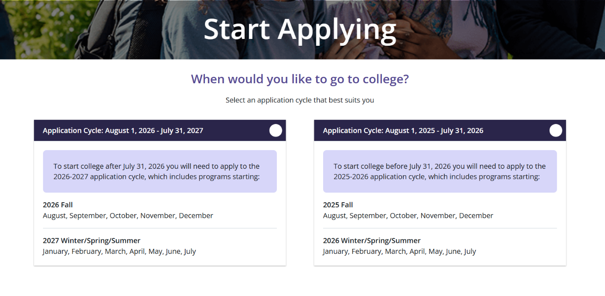
Start Application – Important! Select the correct cycle
Includes programs starting in:
September 2025
January 2026
May 2026

Slide 21
Start Application – Important! Select the correct cycle
Includes programs starting in:
September 2026
January 2027
May 2027

Slide 22
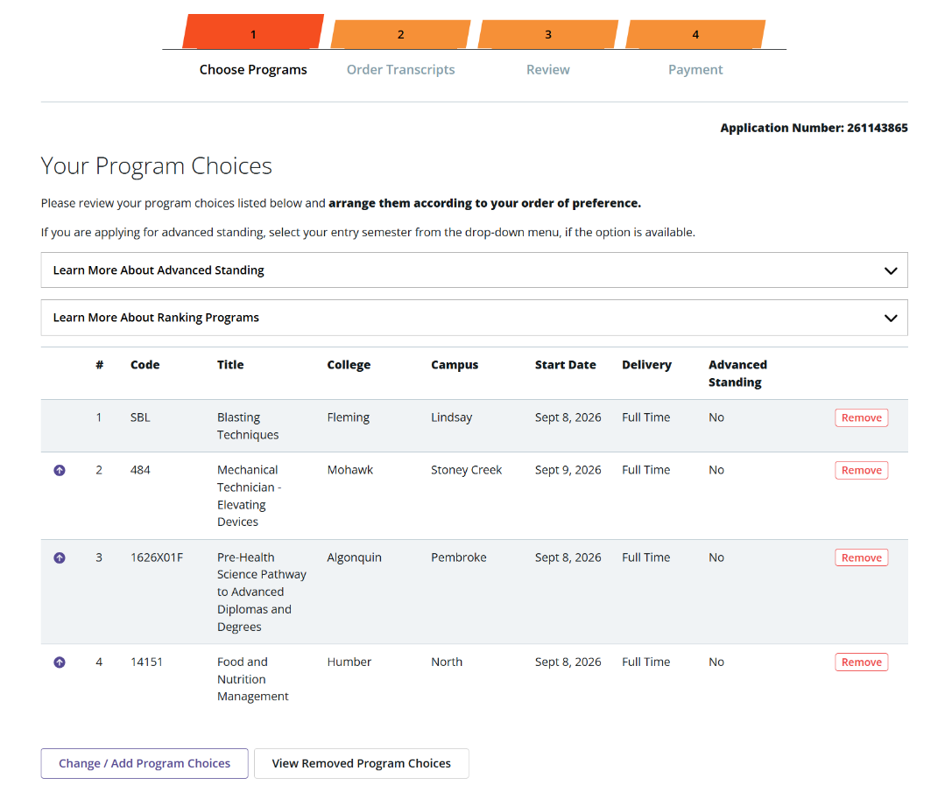
Choose Programs
Program choices can be updated
Change
Or Add

Slide 23
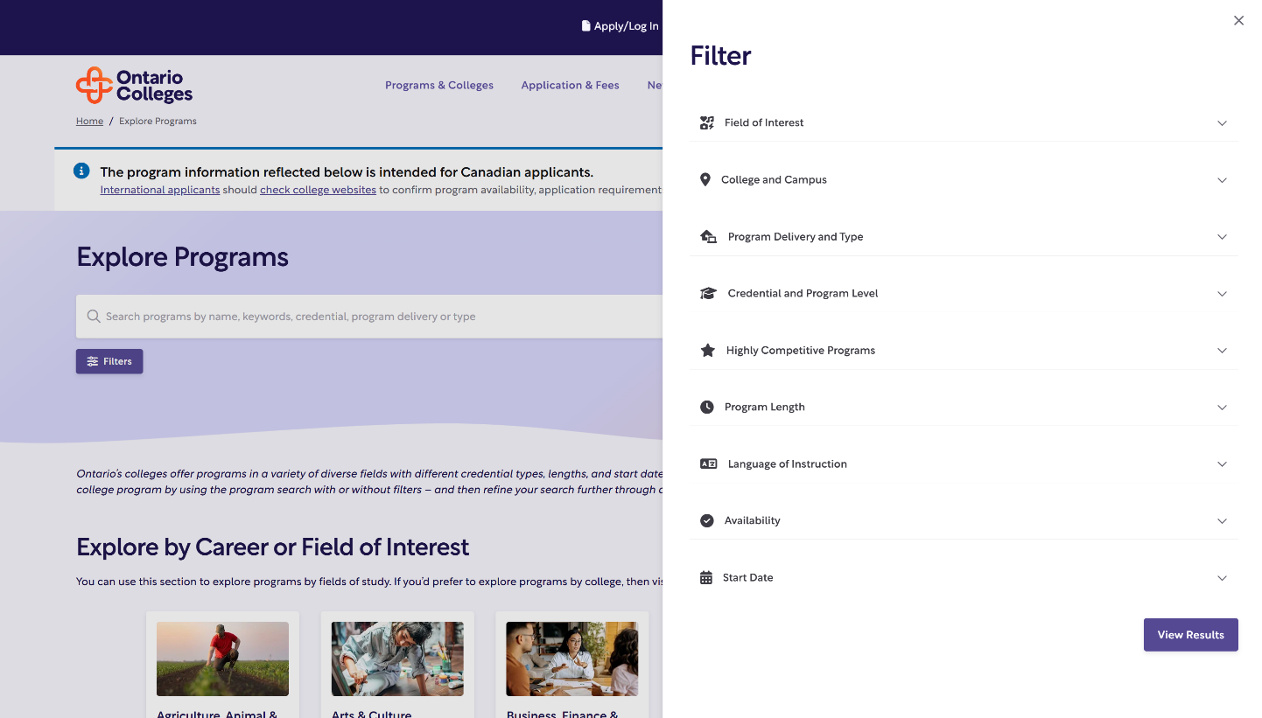
Explore Programs → Filters

Slide 24
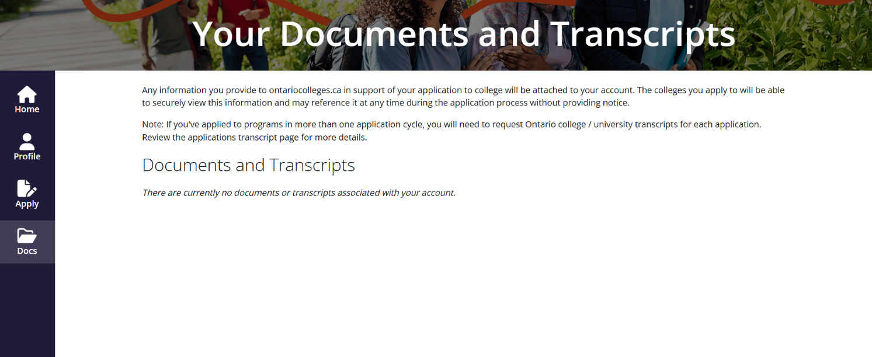
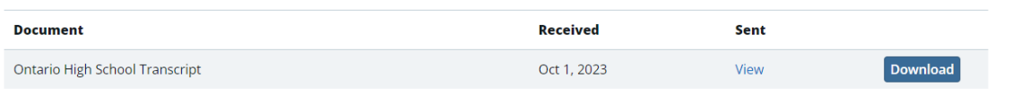
View Received Documents

Slide 25
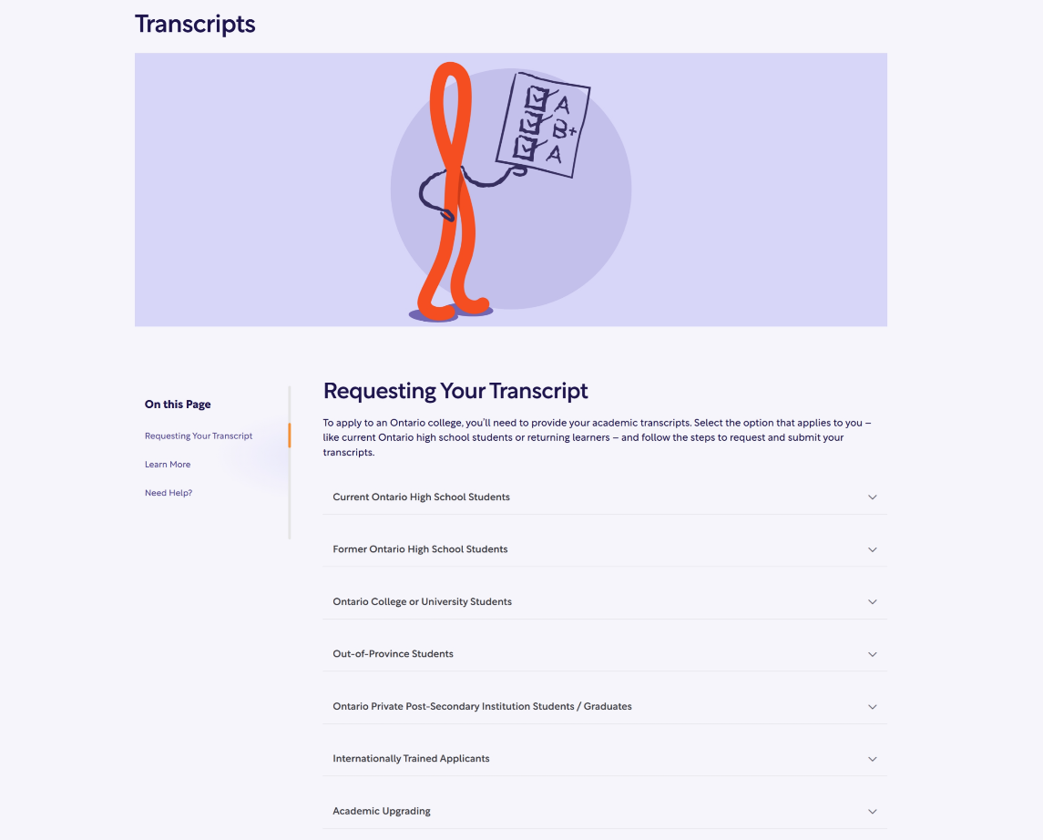
Application & Fees → Transcripts

Slide 26
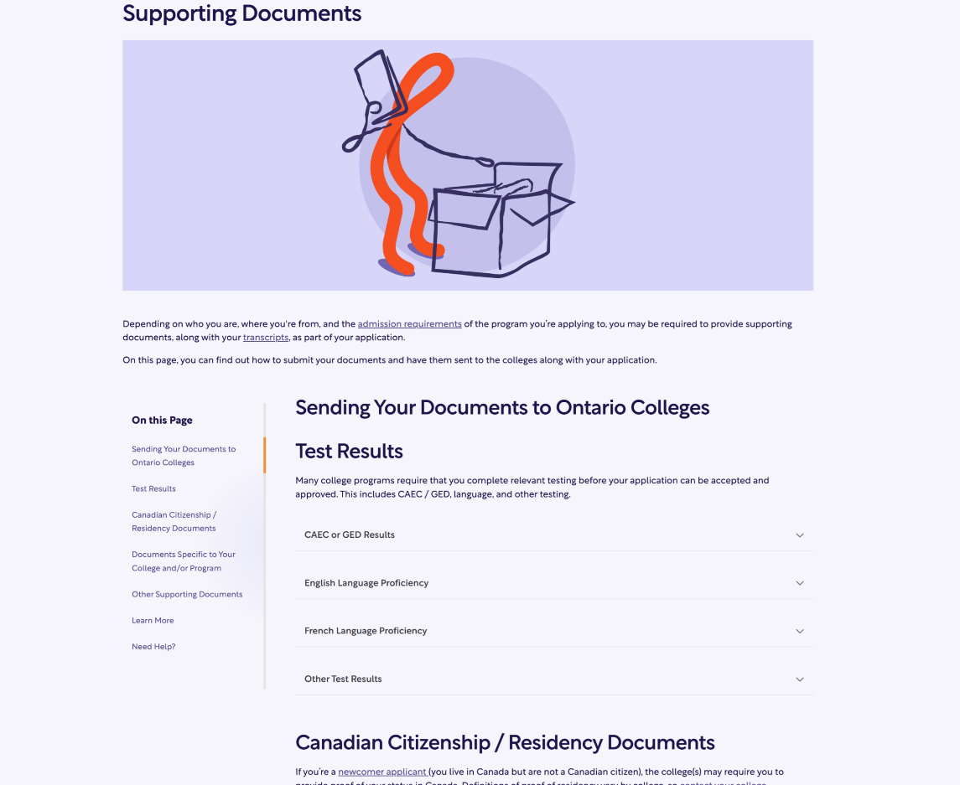
Application & Fees → Supporting Documents

Slide 27
When will I receive an offer?

Slide 28

Important Dates: Offers of Admission
First date that colleges can release offers is November 1st
Offers continue to be released on an ongoing basis
Many offers for highly competitive programs are not released until February 1 or later
Check your application status in your College Portal accounts, or contact the college for clarification
Offers are posted in your Ontario Colleges account

Slide 29

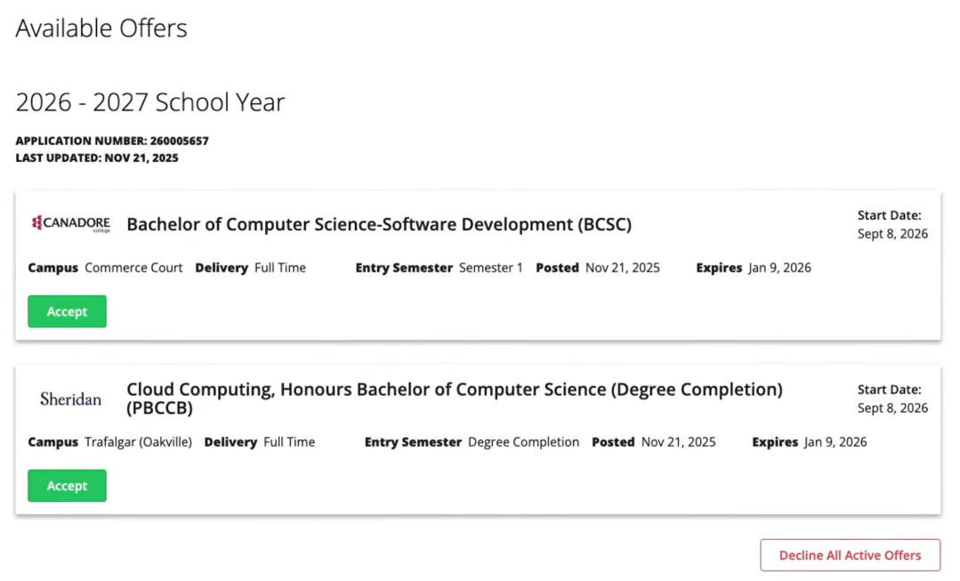
Offers

Slide 30

Important Dates: Equal Consideration Date
Equal consideration date for highly competitive programs is February 1st
Plan to apply before Feb 1, to have the best chance of receiving an offer!
Some programs close on Feb 1, as they are already full
Many programs are available to apply to after February 1st
List of highly competitive programs accessed from this page. https://www.ontariocolleges.ca/en/highly-competitive-programs

Slide 31



How can you reach us?
Phone
Canadian Applicants
+1-519-763-4725
Contact Centre Hours
Monday to Friday:
8:30 a.m. - 4:30 p.m. ET
Chat
Talk with live agents
Accessible from our website
Email
General Inquiries
ask-us@ontariocolleges.ca

Slide 32
Thank you!
Questions?
ask-us@ontariocolleges.ca

